Slide 1
MANHATTAN TRAFFIC
COLLISION MAP
URBAN DATA & MACHINE LEARNING
Chongyang Ren MSAUD 23’
Junling Zhuang MSCDP 23’
Yaoze Yu MSAUD 23’
2023.05.01

Slide 2
CONTENTS
Problem Definition & Research Question
Literature Review & Relevant Publications
List of Data Sources & Description
Methodological Framework
Results
Conclusions

Slide 3
Problem Definition
Research Question
Problem Definition & Research Question
Traffic collisions are a major concern in urban areas, and can lead to severe injuries or fatalities. Manhattan is known for its high-density road network and heavy traffic, making it important to understand the factors that contribute to traffic collisions in this area. In order to reduce the frequency and severity of collisions, it is necessary to identify the intersections that are most prone to accidents and determine the factors that contribute to their danger.
What factors contribute to the frequency and severity of traffic collisions at intersections in Manhattan, and how can this information be used to predict the risk of collisions at different locations?

Slide 4
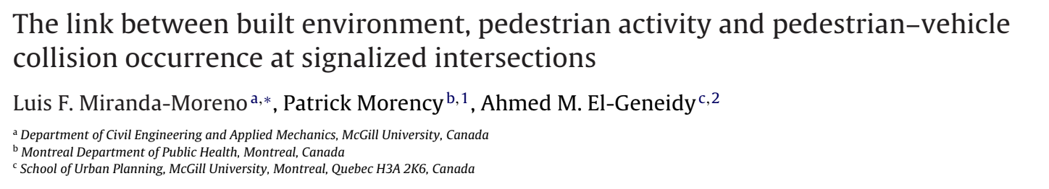
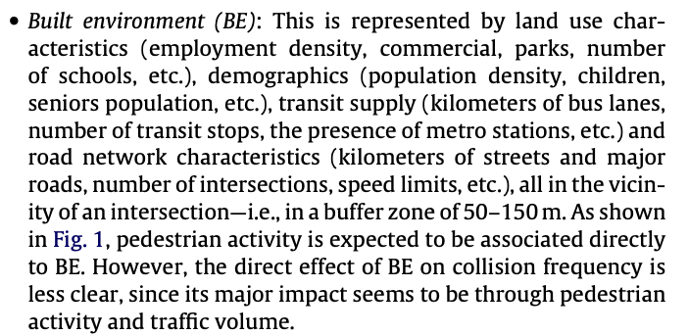
Literature Review & Relevant Publications
Notes:
This conclusion is based on the braking distance at the time of the accident, the number of intersections, speed limits, etc. to obtain a buffer zone

Slide 5
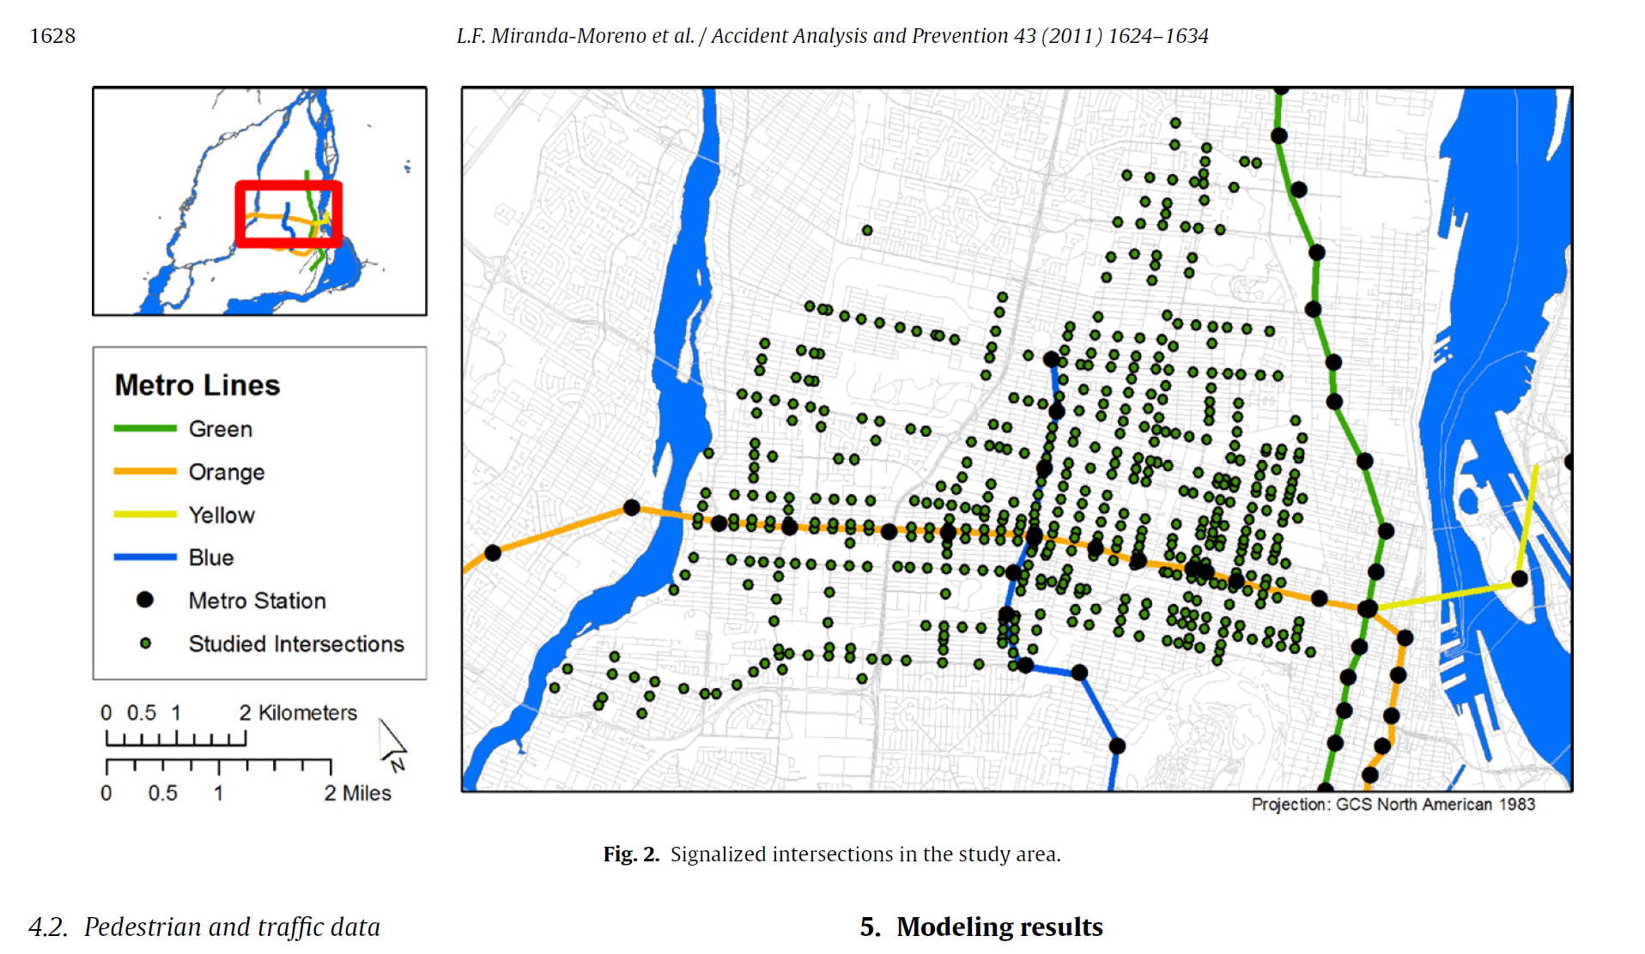
Literature Review & Relevant Publications
Notes:
Take the intersection of the road as the center and make a circle of 50 meters in diameter as a buffer zone

Slide 6

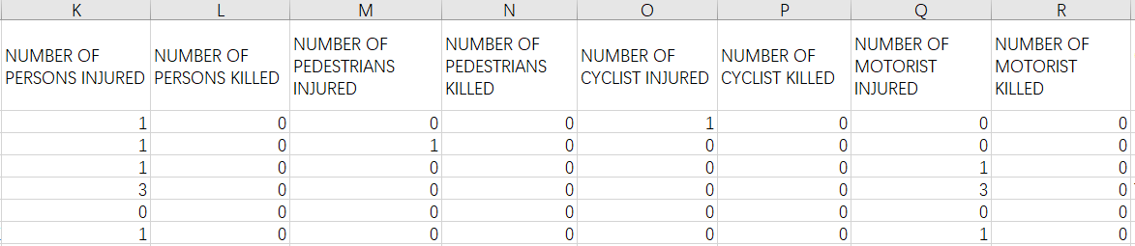
List of Data Sources & Description
https://data.cityofnewyork.us/Public-Safety/Motor-Vehicle-Collisions-Crashes/h9gi-nx95
The Motor Vehicle Collisions crash table contains details on the crash event. Each row represents a crash event. The Motor Vehicle Collisions data tables contain information from all police reported motor vehicle collisions in NYC.
This dataset contains records of crash date, crash time and crash location and further detailed description. We extract number of persons injured and number of persons killed as the most important variable.

Slide 7
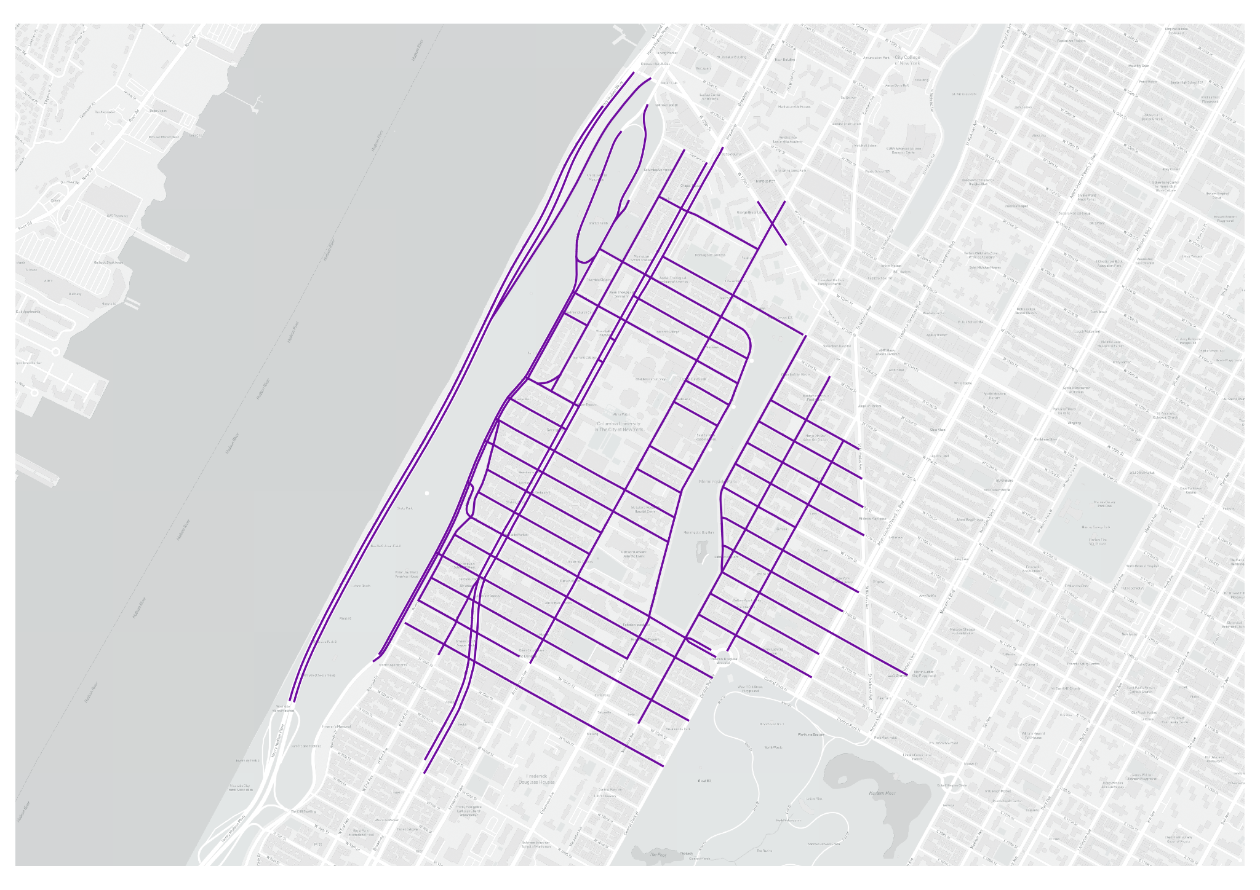
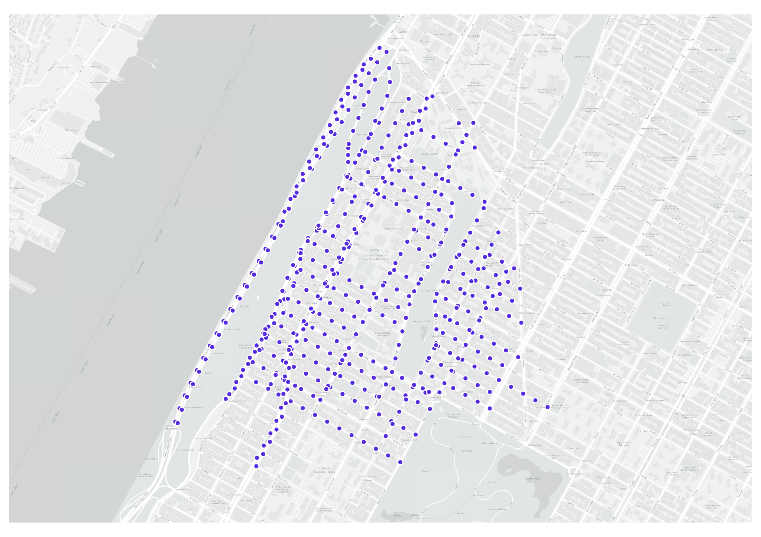
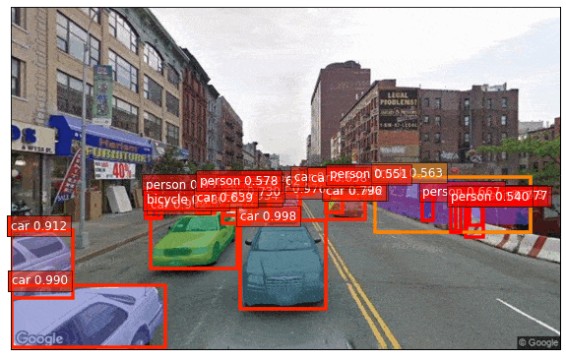
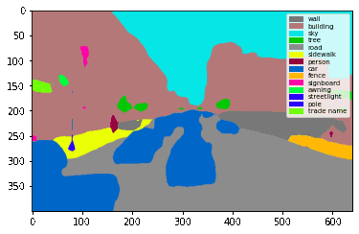
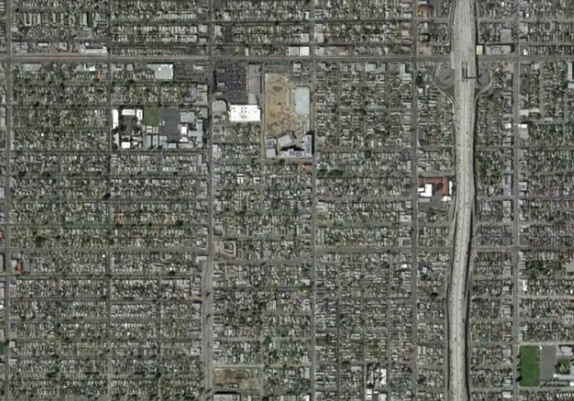
A. According to each 50 meter road intersection, the superimposition amount of the traffic collision data contained inside is counted(2020-2022), and Y1 is obtained.
B. Count the number of traffic collision points on the street Within 50m of each road intersection, and the Y2 is obtained.
C. For the classification of normal vehicle and micro mobility released.
Dependent variable(Y) -
Traffic collision risk
Methodological Framework
A. Google Street View from API, 50m interval.
Supervised regression(test the MAE,MSE,R2)
LGBM
SVM
Random forest(RF)
KNN
Boosting
Decision Tree
QGIS get points
Machine learning prediction
B. Computer Vision Pre-training model to quantify street view features (Segmentation and Object recognition), and Find the mean of street features in each neighborhood
Independent variable(X) -
Street features & Satellite image
Mask R-CNN(features number)
Psp-Net(features ratio)
C. Land cover image download : 1.Download Land use data for the most recent year（2017） 2. Calculated the proportion of different 50m traffic intersection buffer circles.

Slide 8
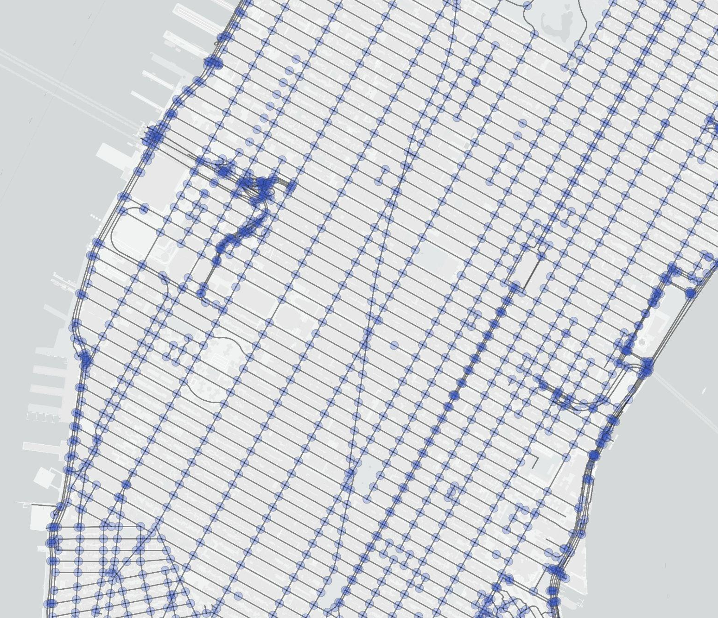
Buffer Zone Analytical Visualization
Road intersections
25m
Notes:
一个曼哈顿岛的底图,上面有以buffer为中心的点,点的颜色需要根据交通事故的数据大小变化,需要一个图例来表示颜色,共两张,一张是数量,另一张是对行人的影响

Slide 9
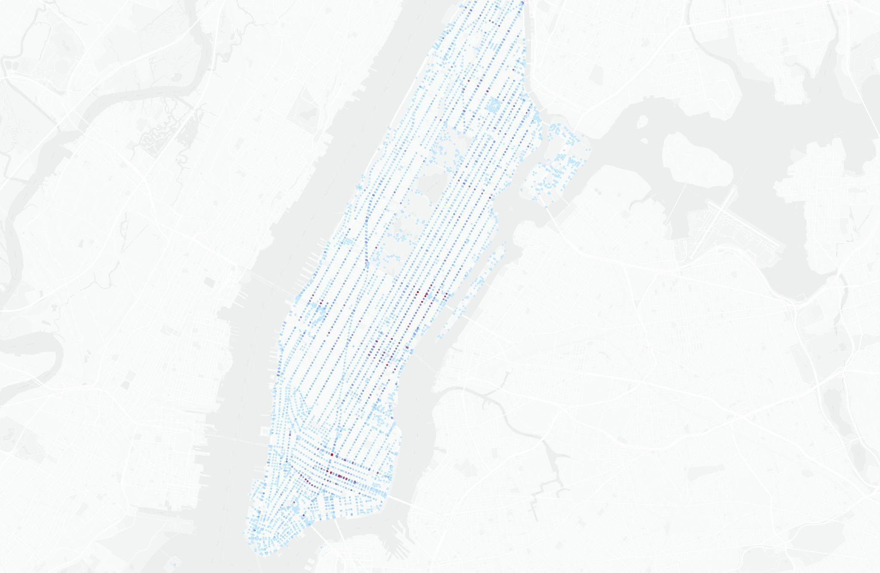
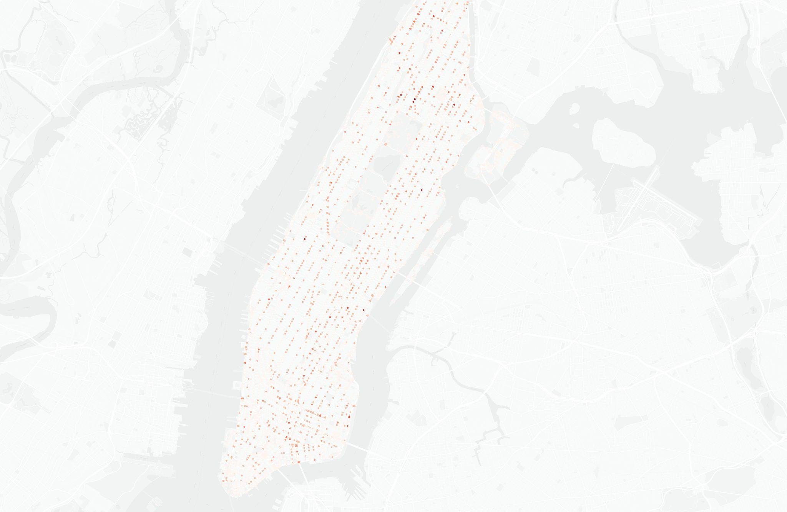
Buffer Zone Analytical Visualization
33
12
0
0
The number of traffic collisions in the buffer
The number of injured persons in the buffer (killed included)
Notes:
一个曼哈顿岛的底图,上面有以buffer为中心的点,点的颜色需要根据交通事故的数据大小变化,需要一个图例来表示颜色,共两张,一张是数量,另一张是对行人的影响

Slide 10
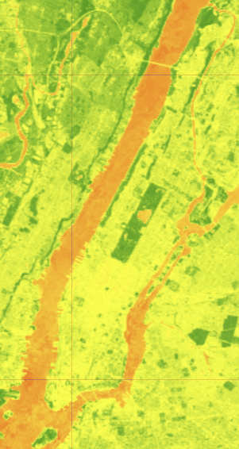
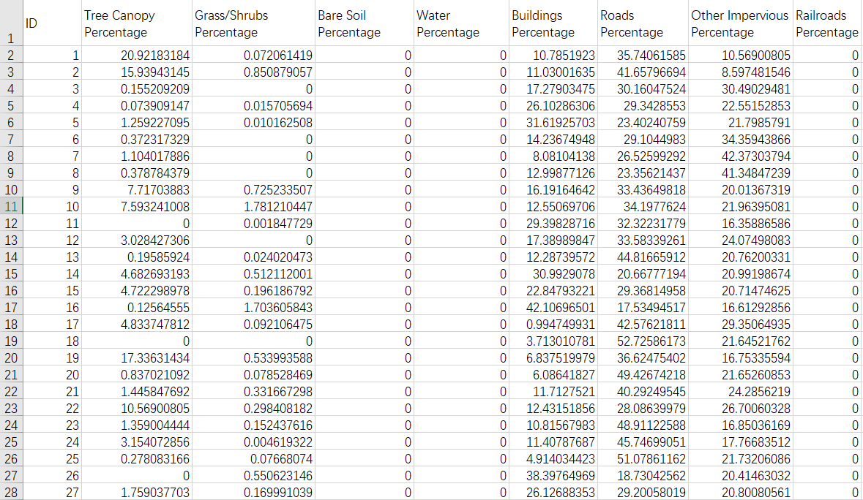
Landcover Dataset
Notes:
landcover截图

Slide 11
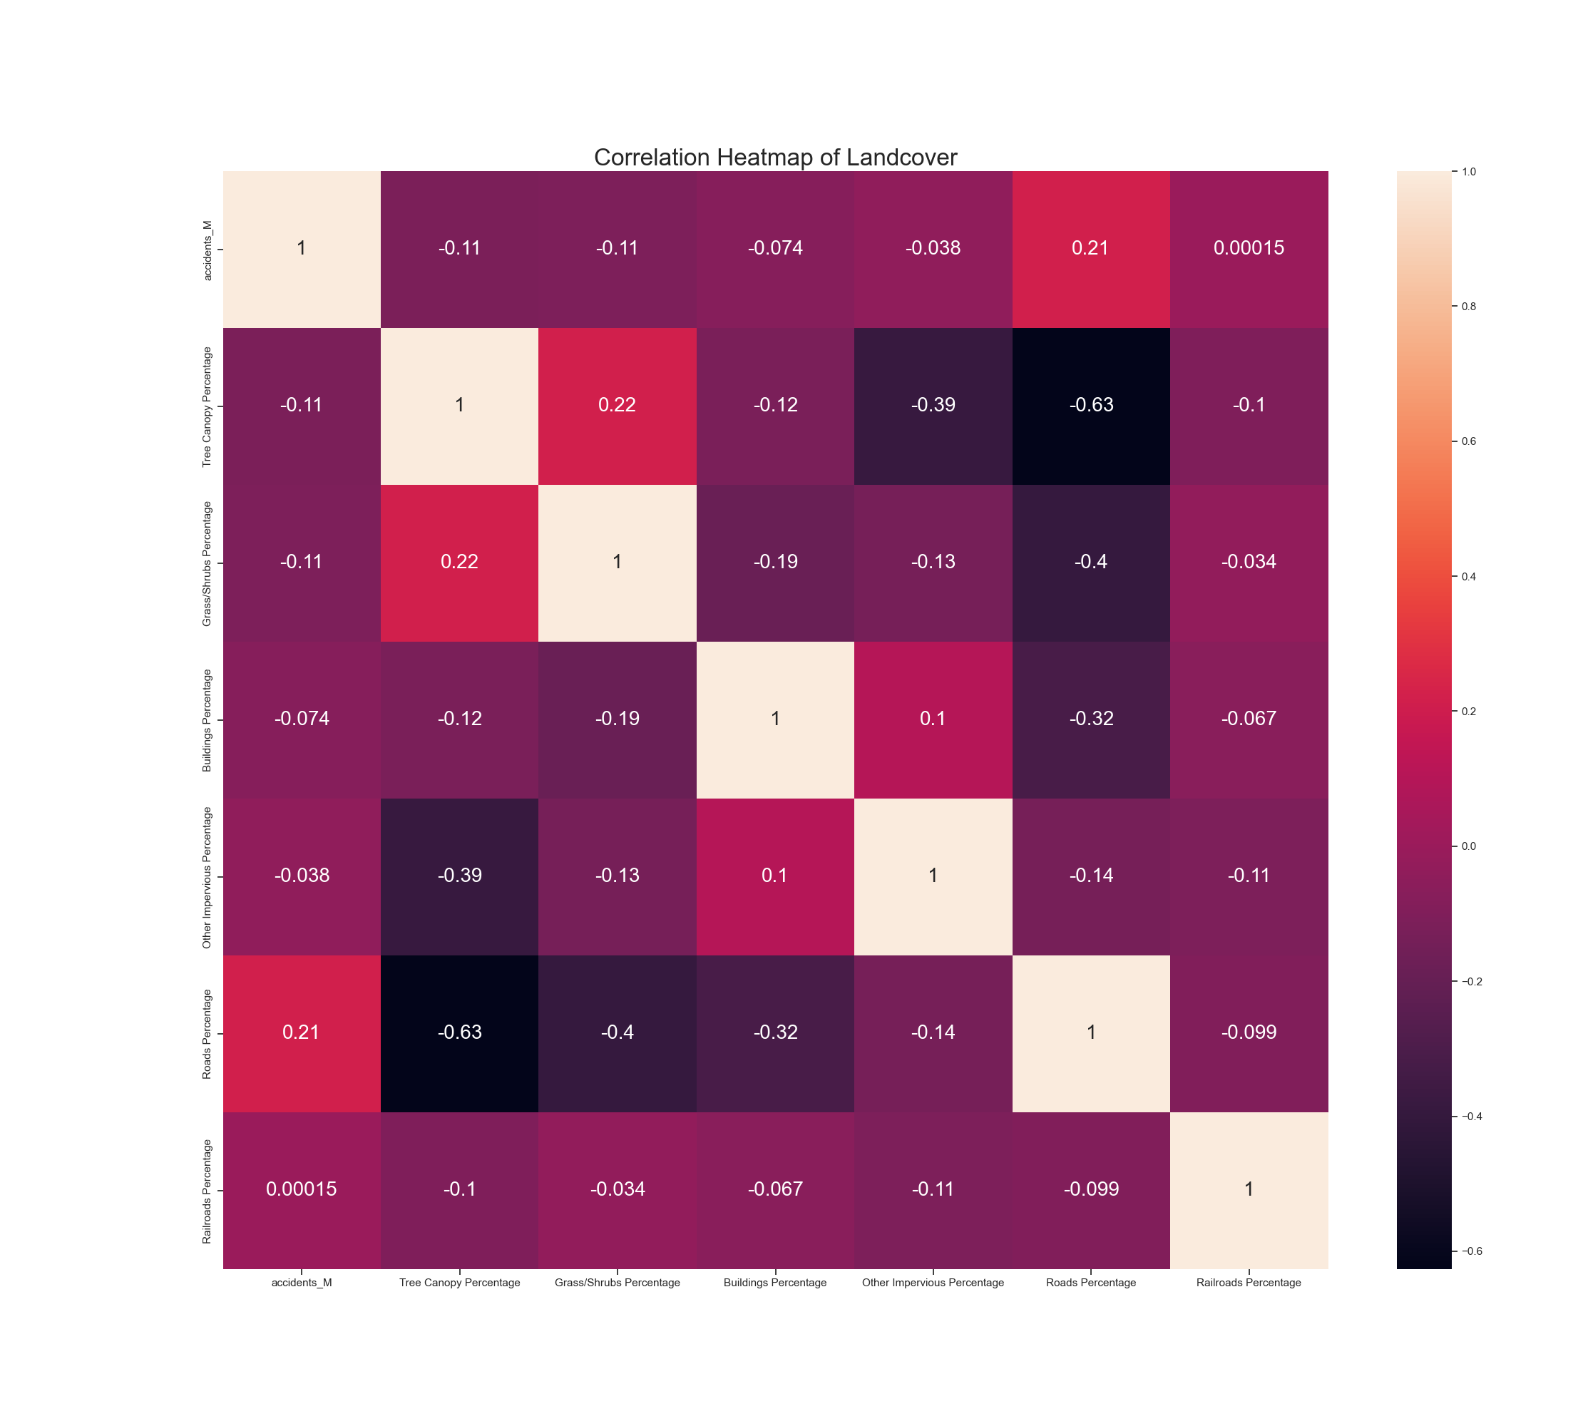
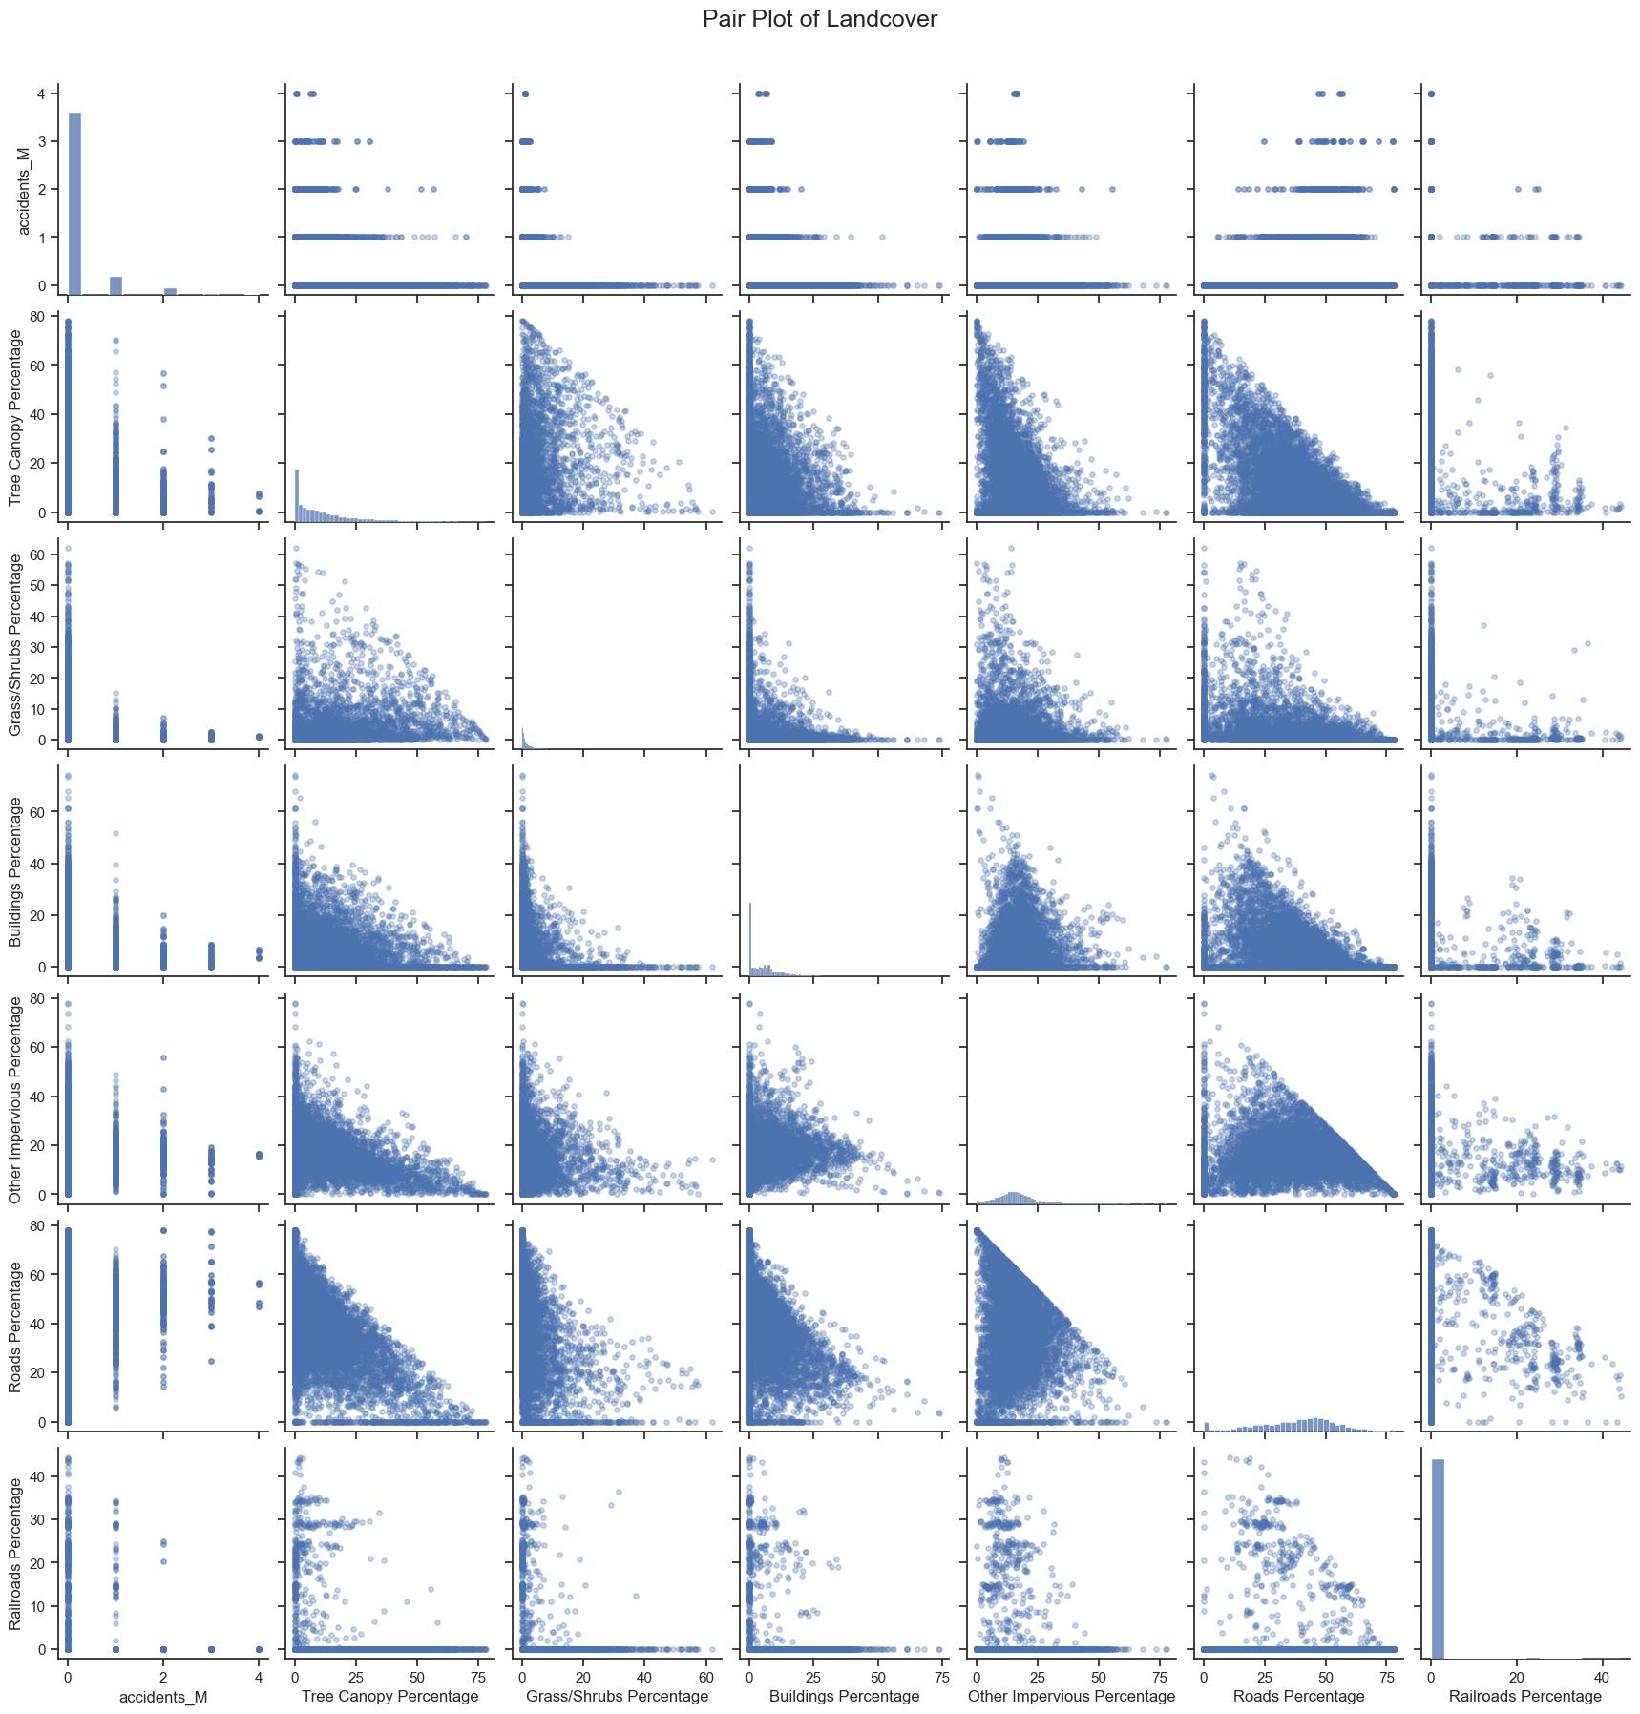
Exploratory Analysis – Land Cover

Slide 12
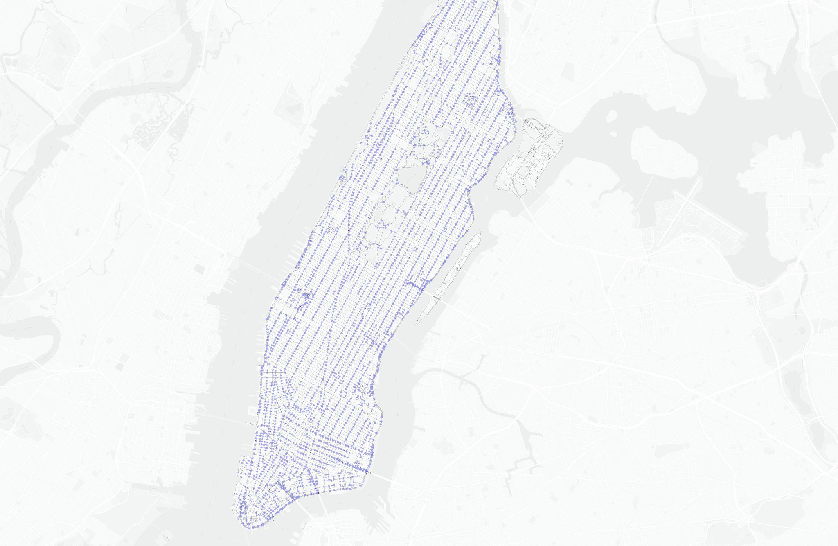
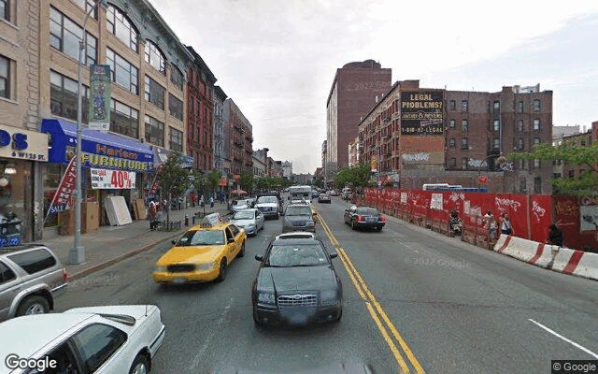
Street View Dataset-
Street View Points within buffer zones
Notes:
左边是buffer中street view的点

Slide 13
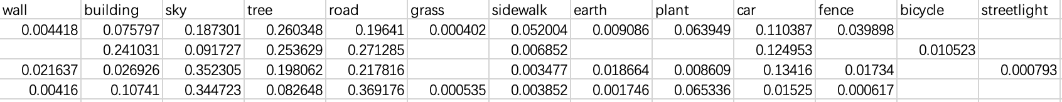
Street View Dataset- Psp Net
Notes:
左边是buffer中street view的点

Slide 14
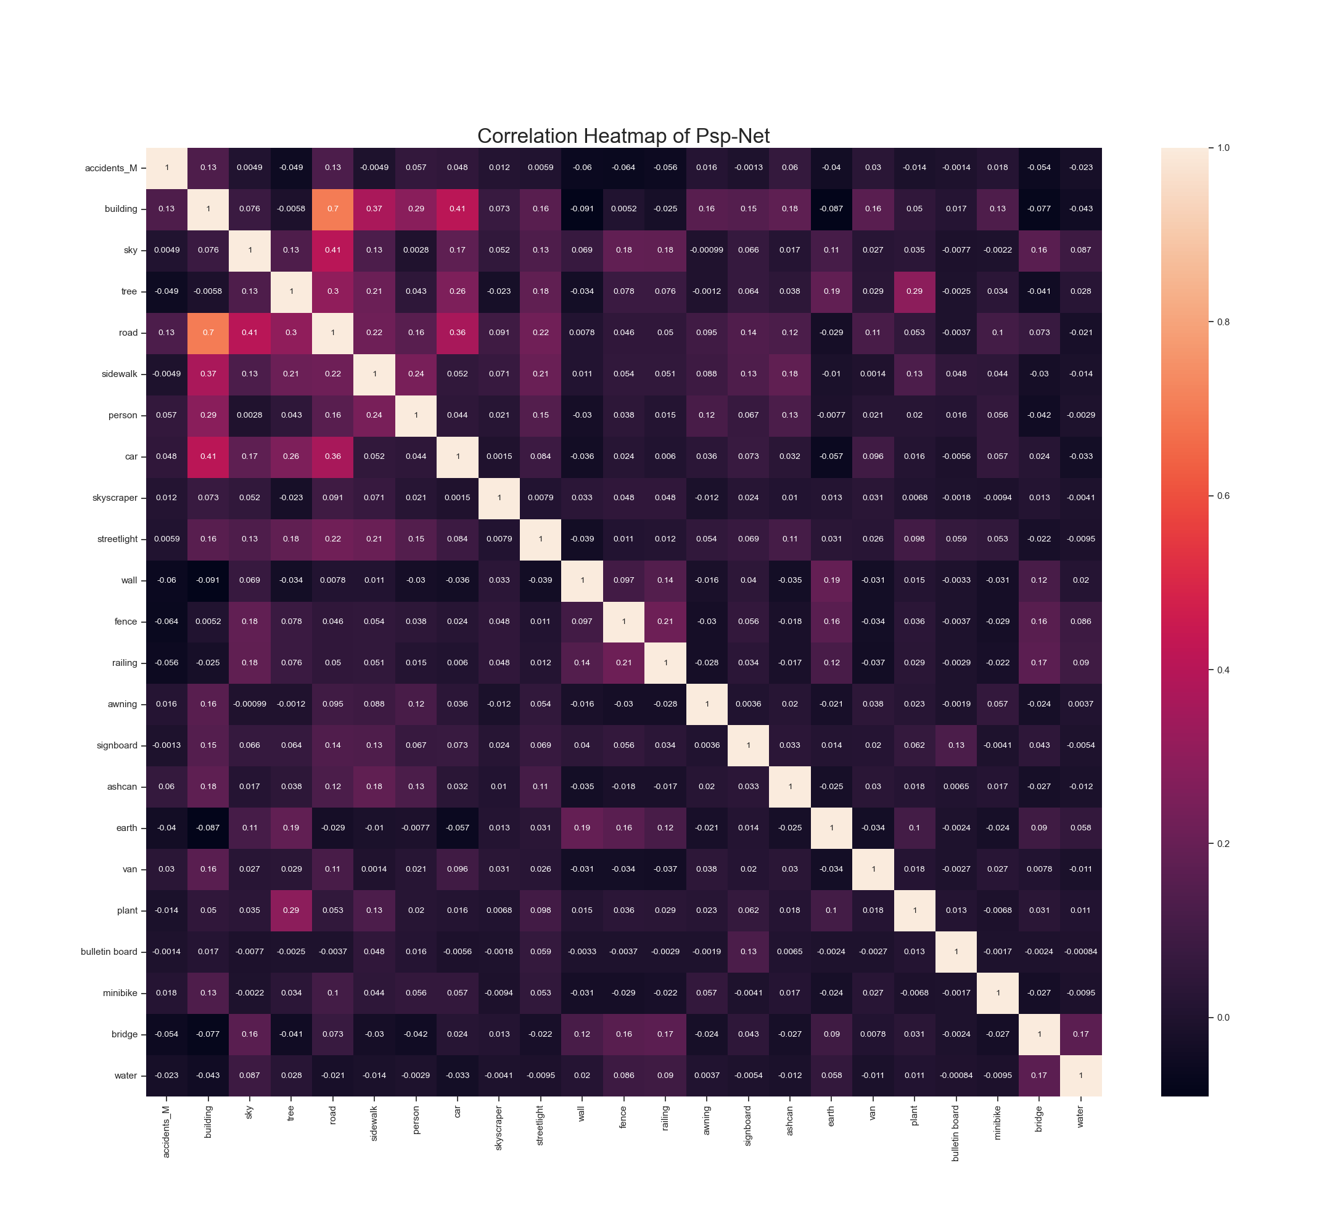
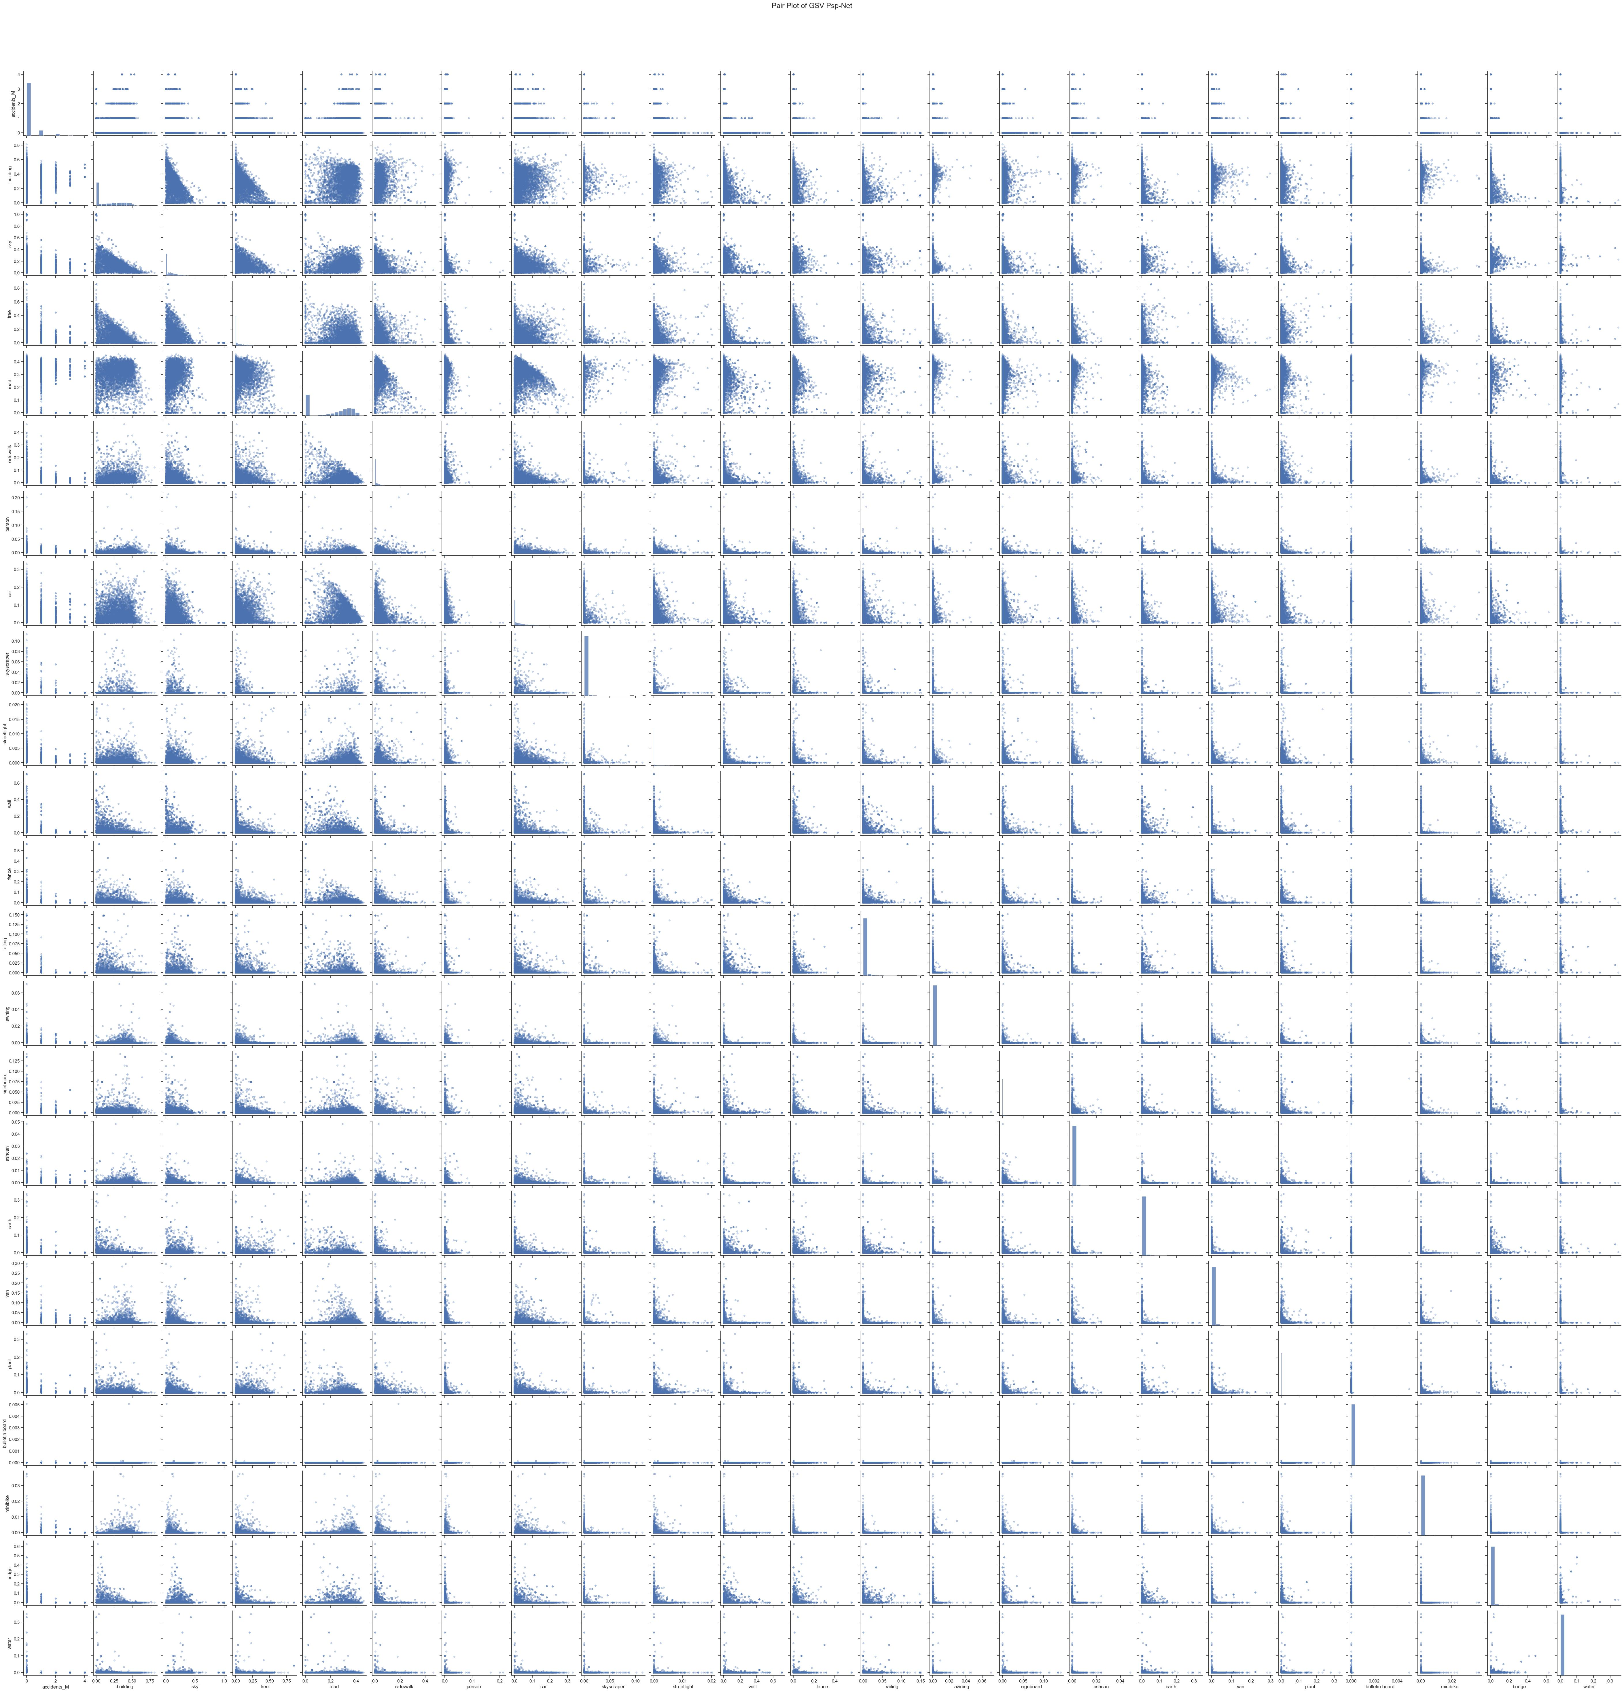
Exploratory Analysis - Psp Net

Slide 15
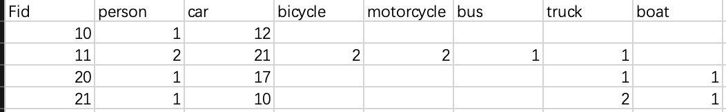
Street View Dataset-Mask RCNN
Notes:
左边是buffer中street view的点

Slide 16
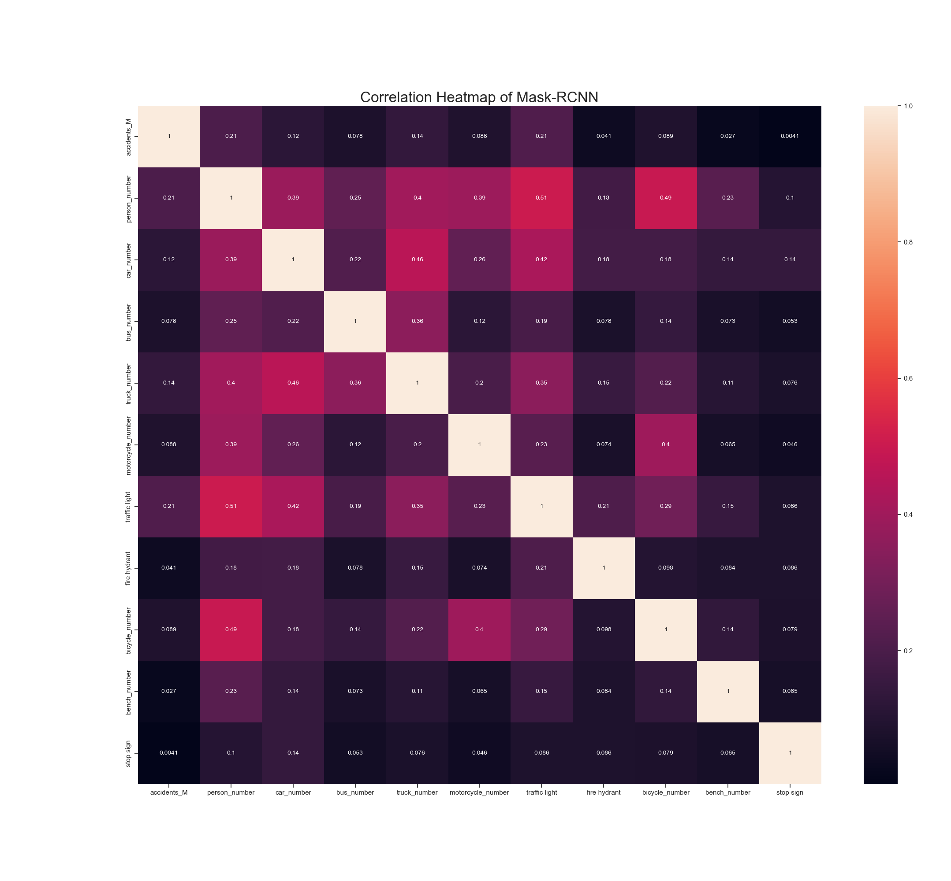
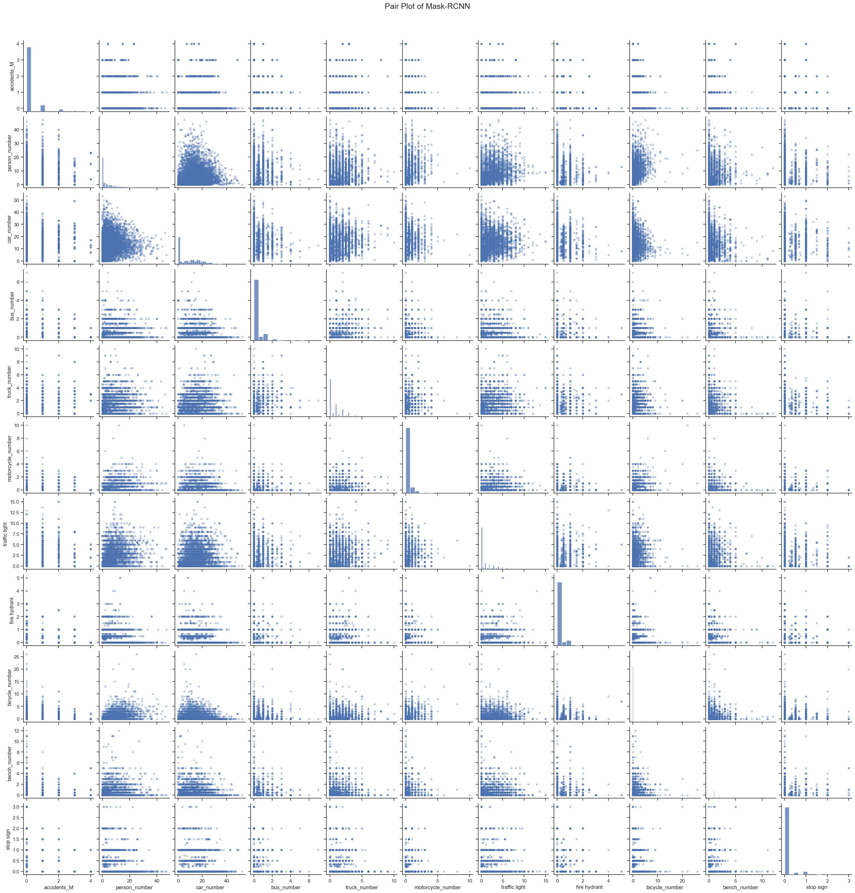
Exploratory Analysis - Mask RCNN

Slide 17
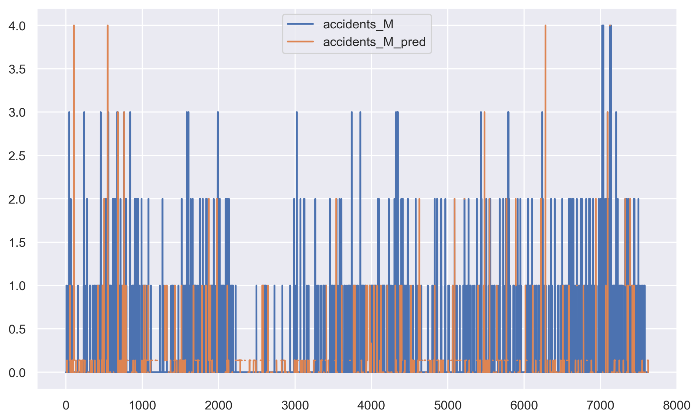
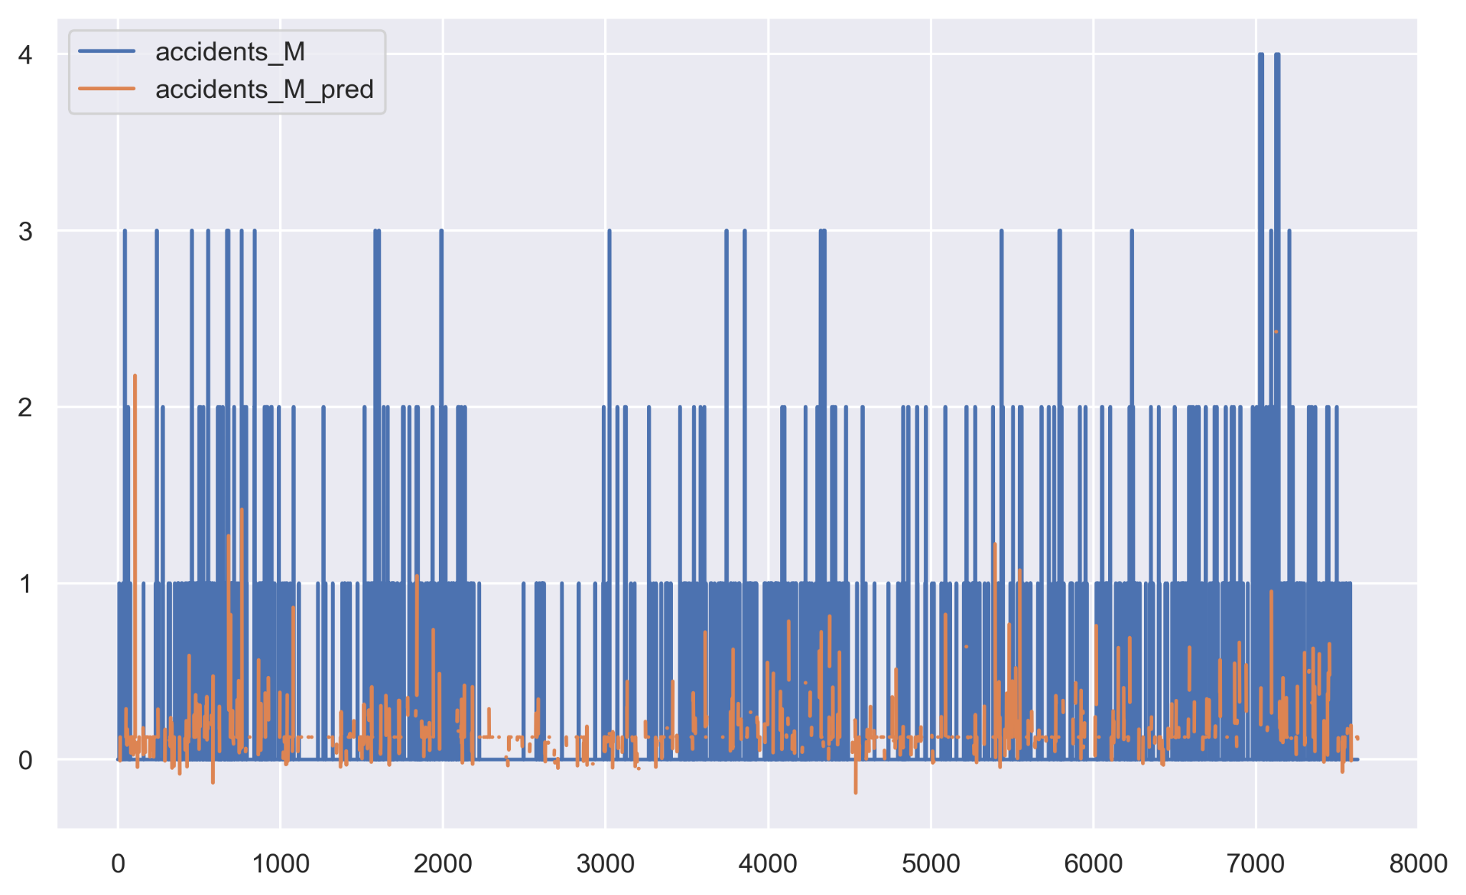
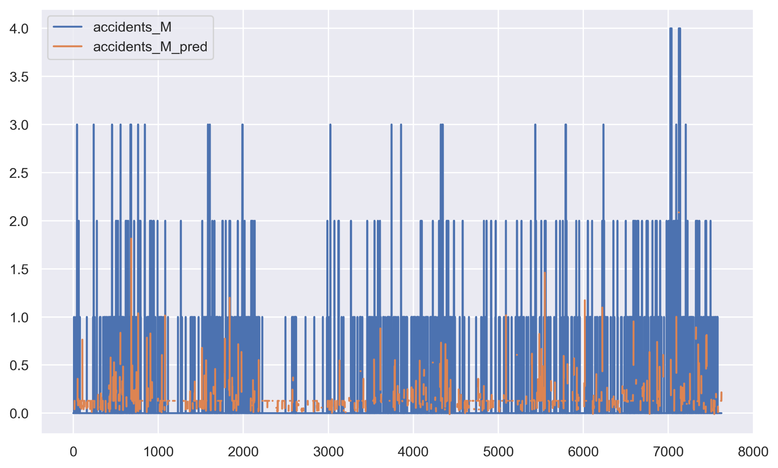
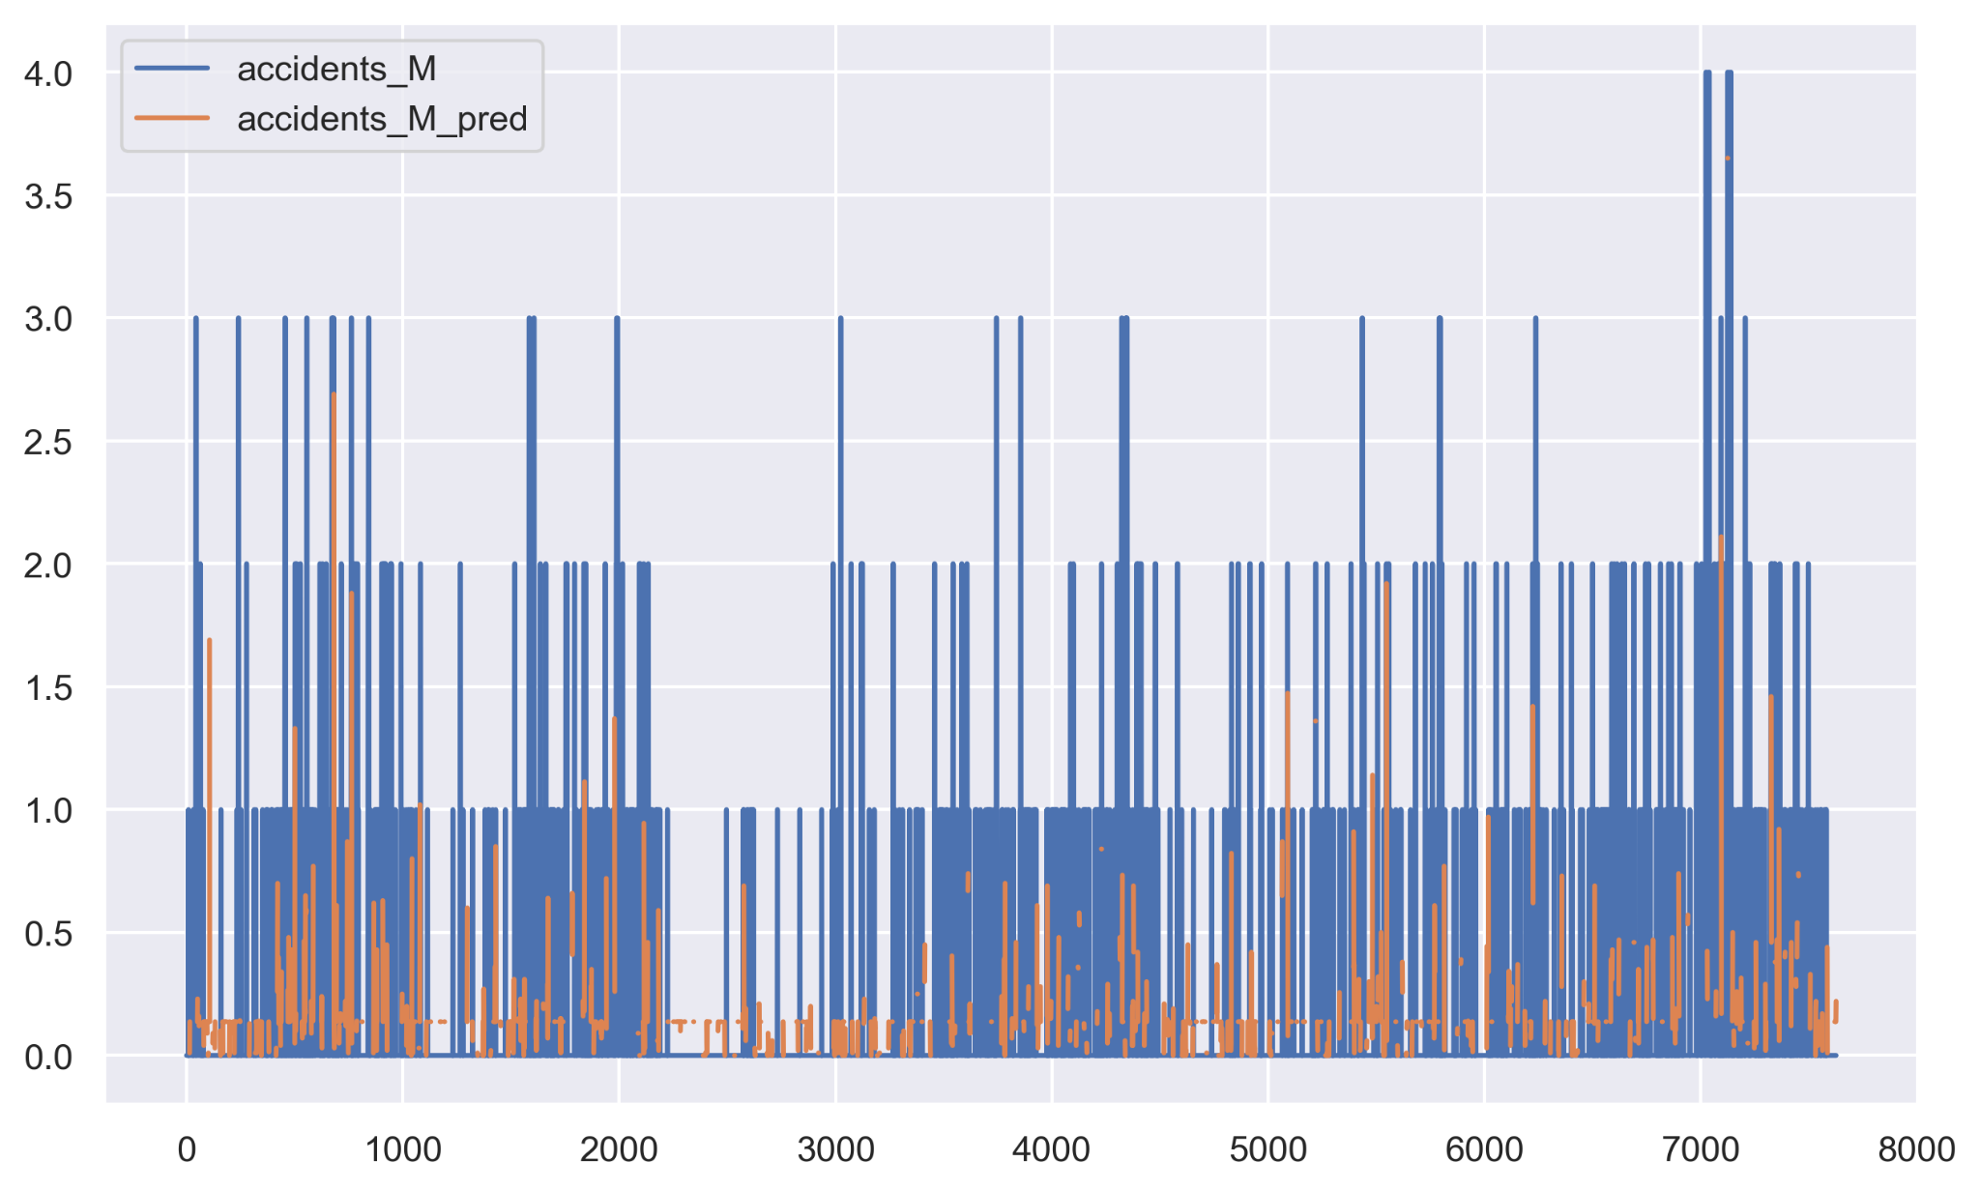
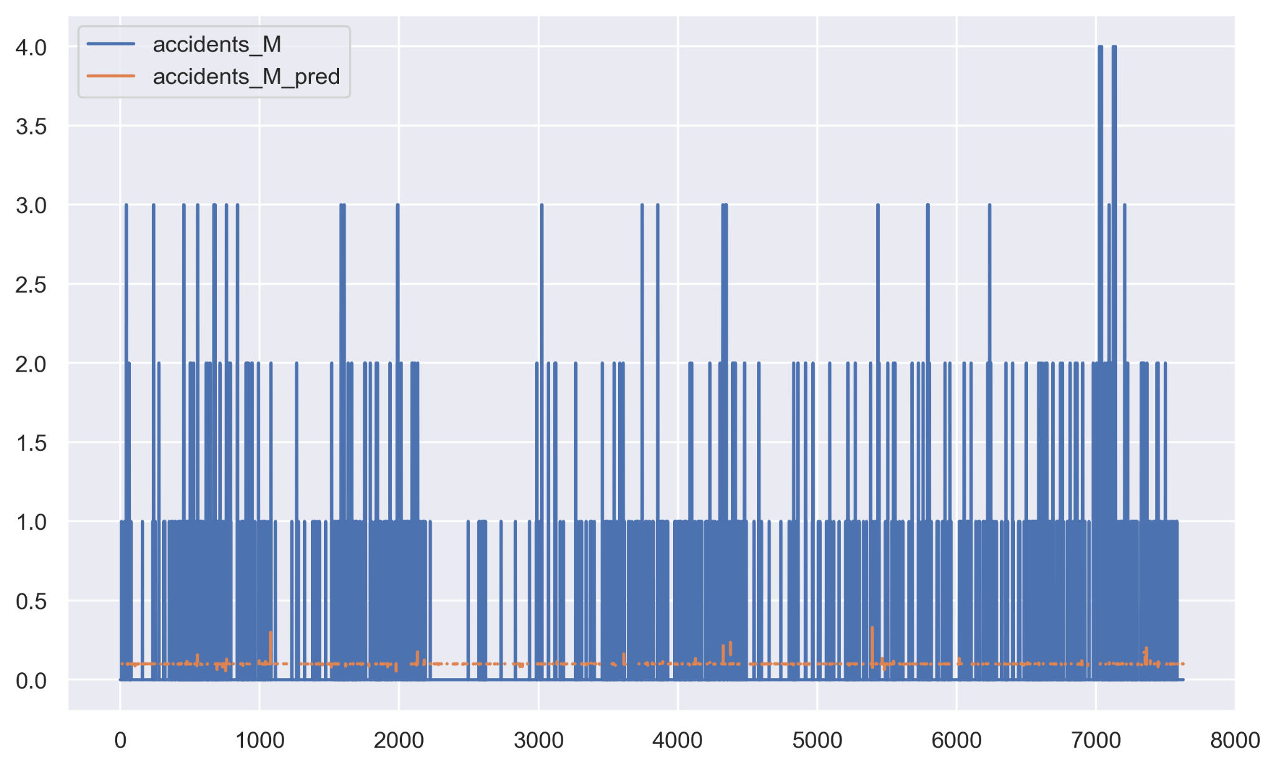
Micromobility_GSV—— Results
LGBM Model
Svm Model
Random Forest model
R2: 0.278
MAE: 0.273
RMSE: 0.462
R2: -0.024
MAE: 0.265
RMSE: 0.551
R2: 0.417
MAE: 0.248
RMSE: 0.416
Decision Tree model
Boosting Model
KNN Model
R2: -0.023
MAE: 0.246
RMSE: 0.55
R2: 0.225
MAE: 0.285
RMSE: 0.479
R2: 0.068
MAE: 0.241
RMSE: 0.525
Notes:
Firstly, for Micromobility, we conducted a regression analysis between the number of accidents events within the traffic intersection buffer, considering only GSV data, and the street-level built environment features segmented by Mask R-CNN and PSPNet. The LightGBM, Gradient Boosting, and Random Forest models all achieved an R2 score greater than 0.2. The MAE and RMSE values were centered around 0.2 and 0.4, respectively.

Slide 18
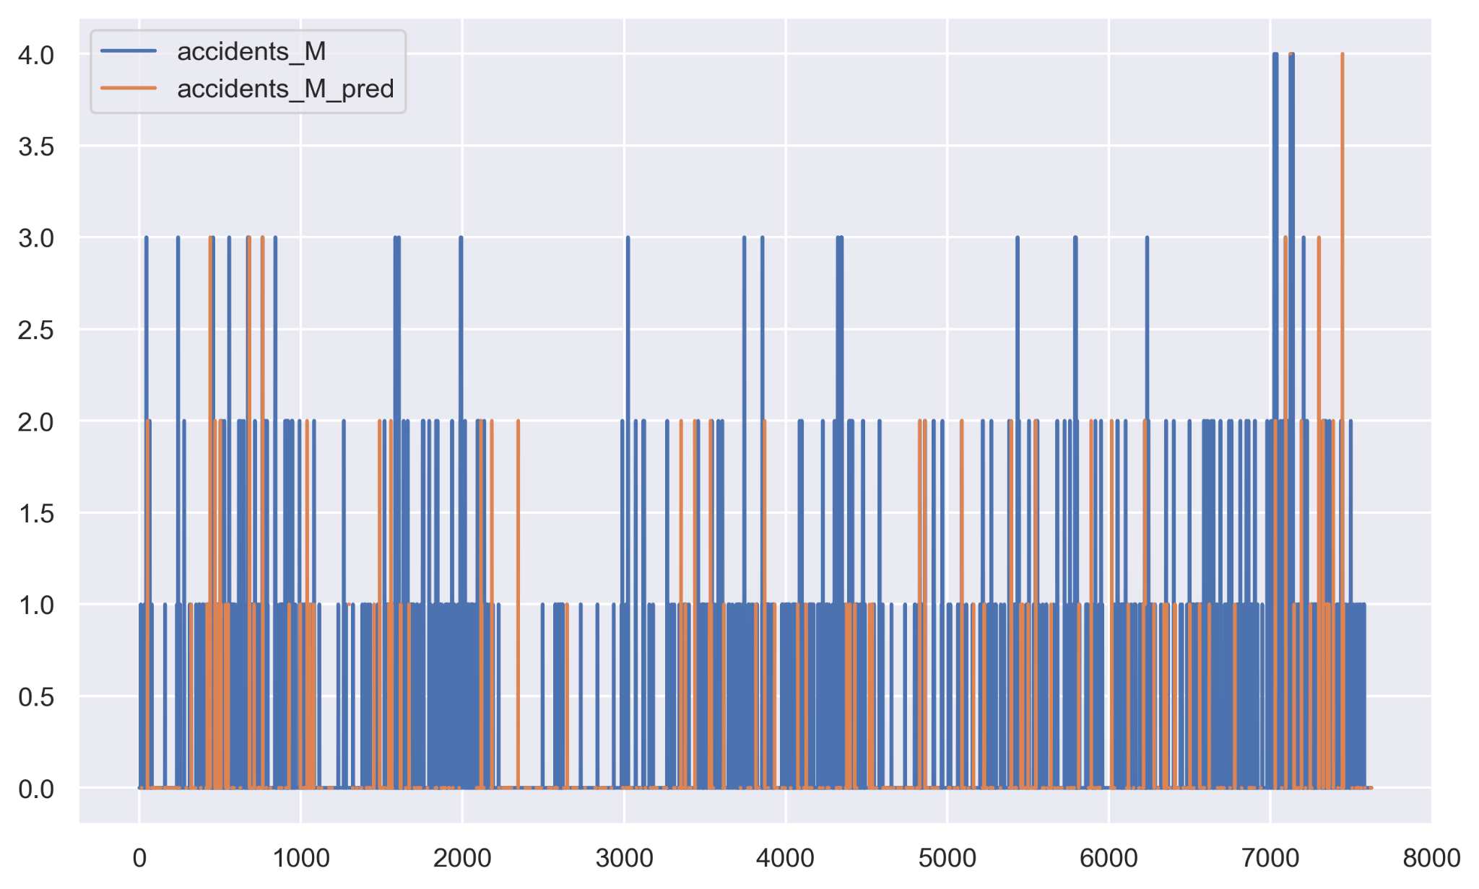

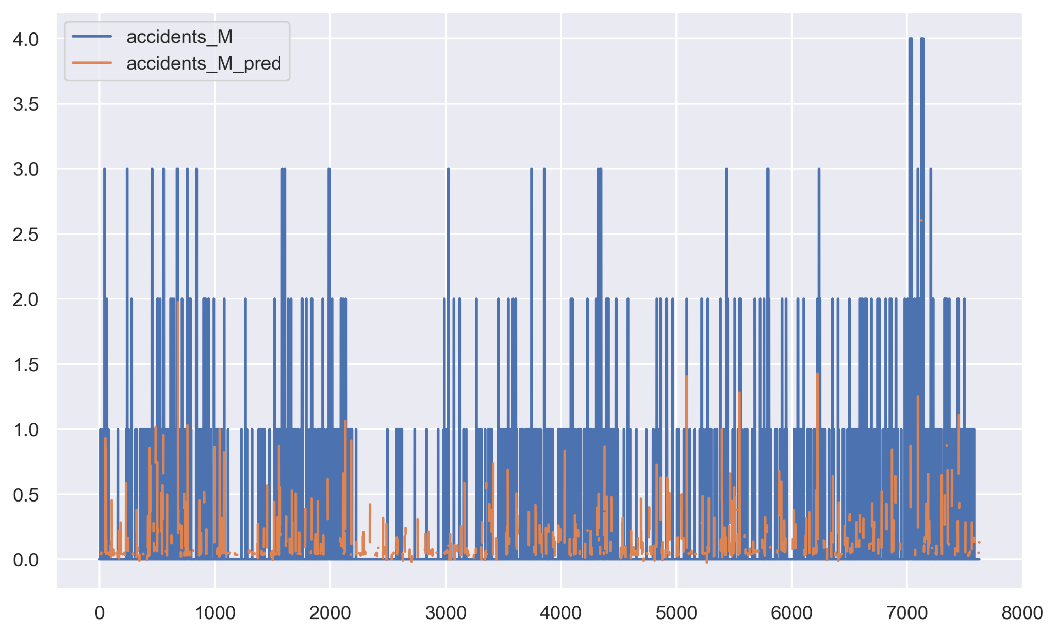


Micromobility_GSV +Land Cover—— Results
Random Forest Model
LGBM Model
Svm Model
Random Forest model
R2: 0.335
MAE: 0.254
RMSE: 0.444
R2: -0.023
MAE: 0.264
RMSE: 0.551
R2: 0.527
MAE: 0.22
RMSE: 0.374
Decision Tree Model
Boosting Model
KNN Model
R2: 0.023
MAE: 0.211
RMSE: 0.538
R2: 0.286
MAE: 0.267
RMSE: 0.46
R2: 0.183
MAE: 0.253
RMSE: 0.492
Notes:
However, when we incorporated Land Cover into our analysis, the overall R2 scores experienced a significant improvement, particularly for the Random Forest model, which increased from 0.41 to 0.52. The RMSE values for each model also decreased by approximately 0.5 to 0.1 when compared to the cases considering only GSV data.

Slide 19
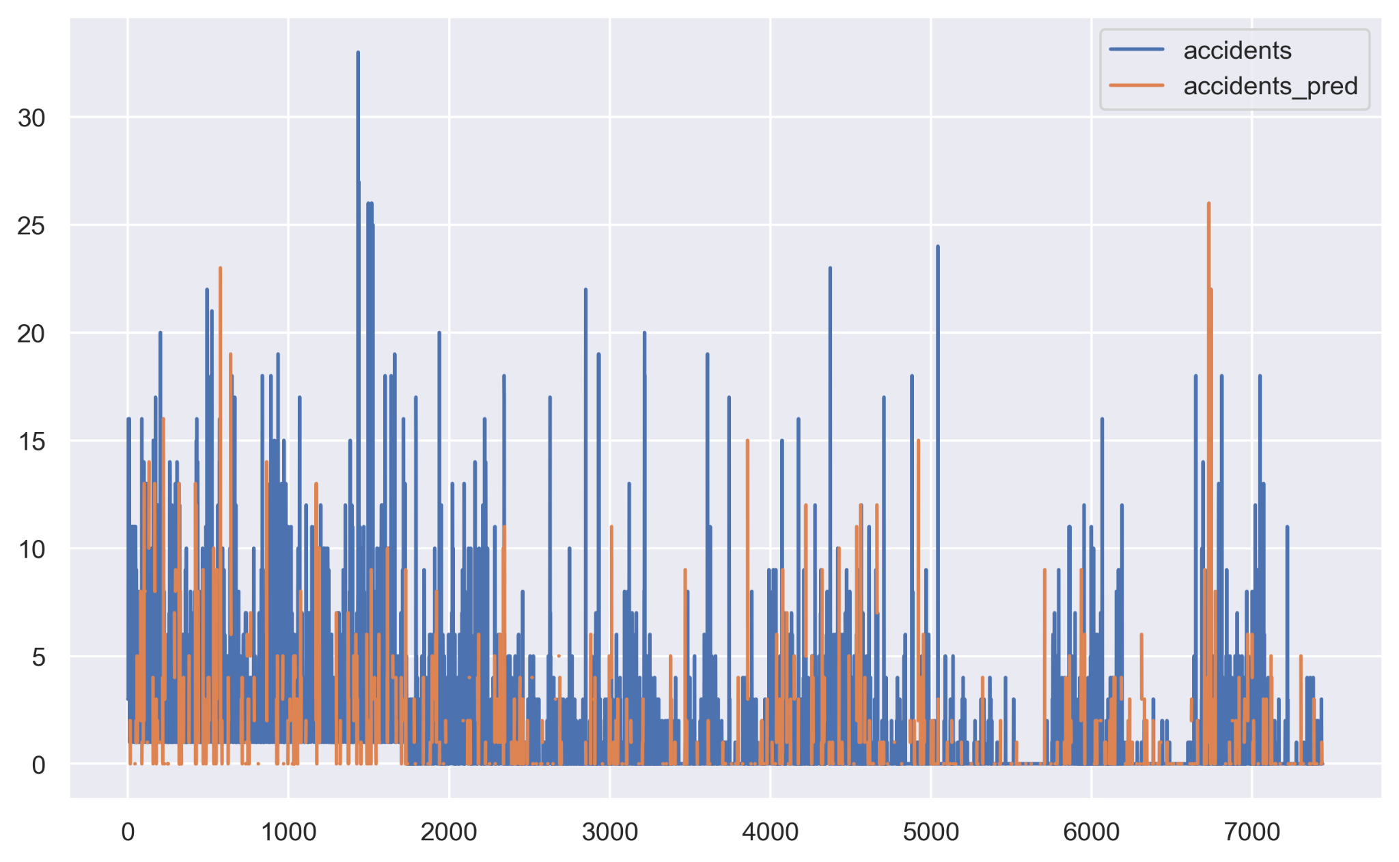
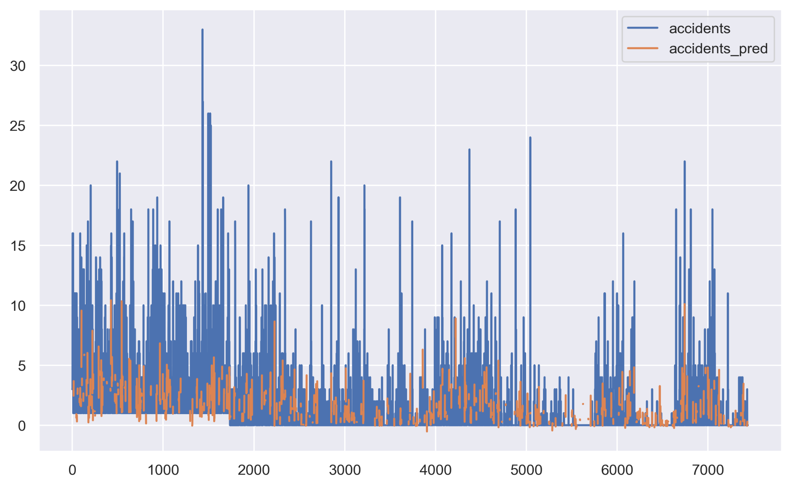
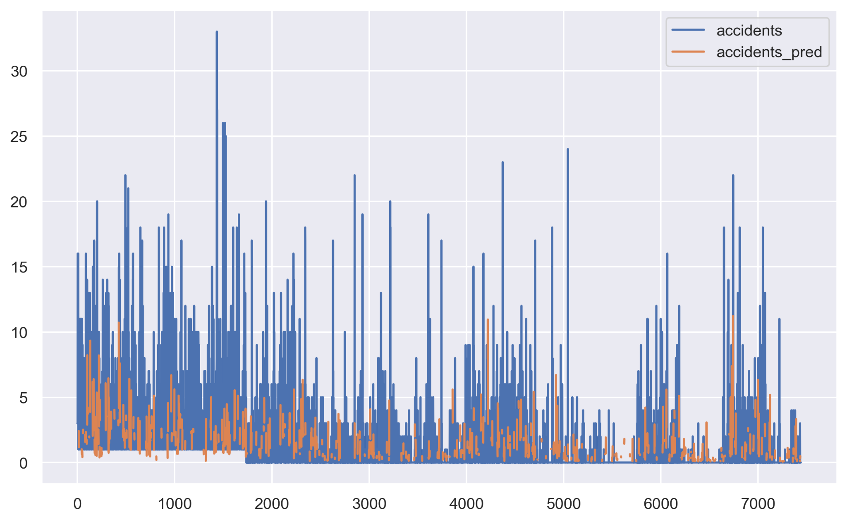

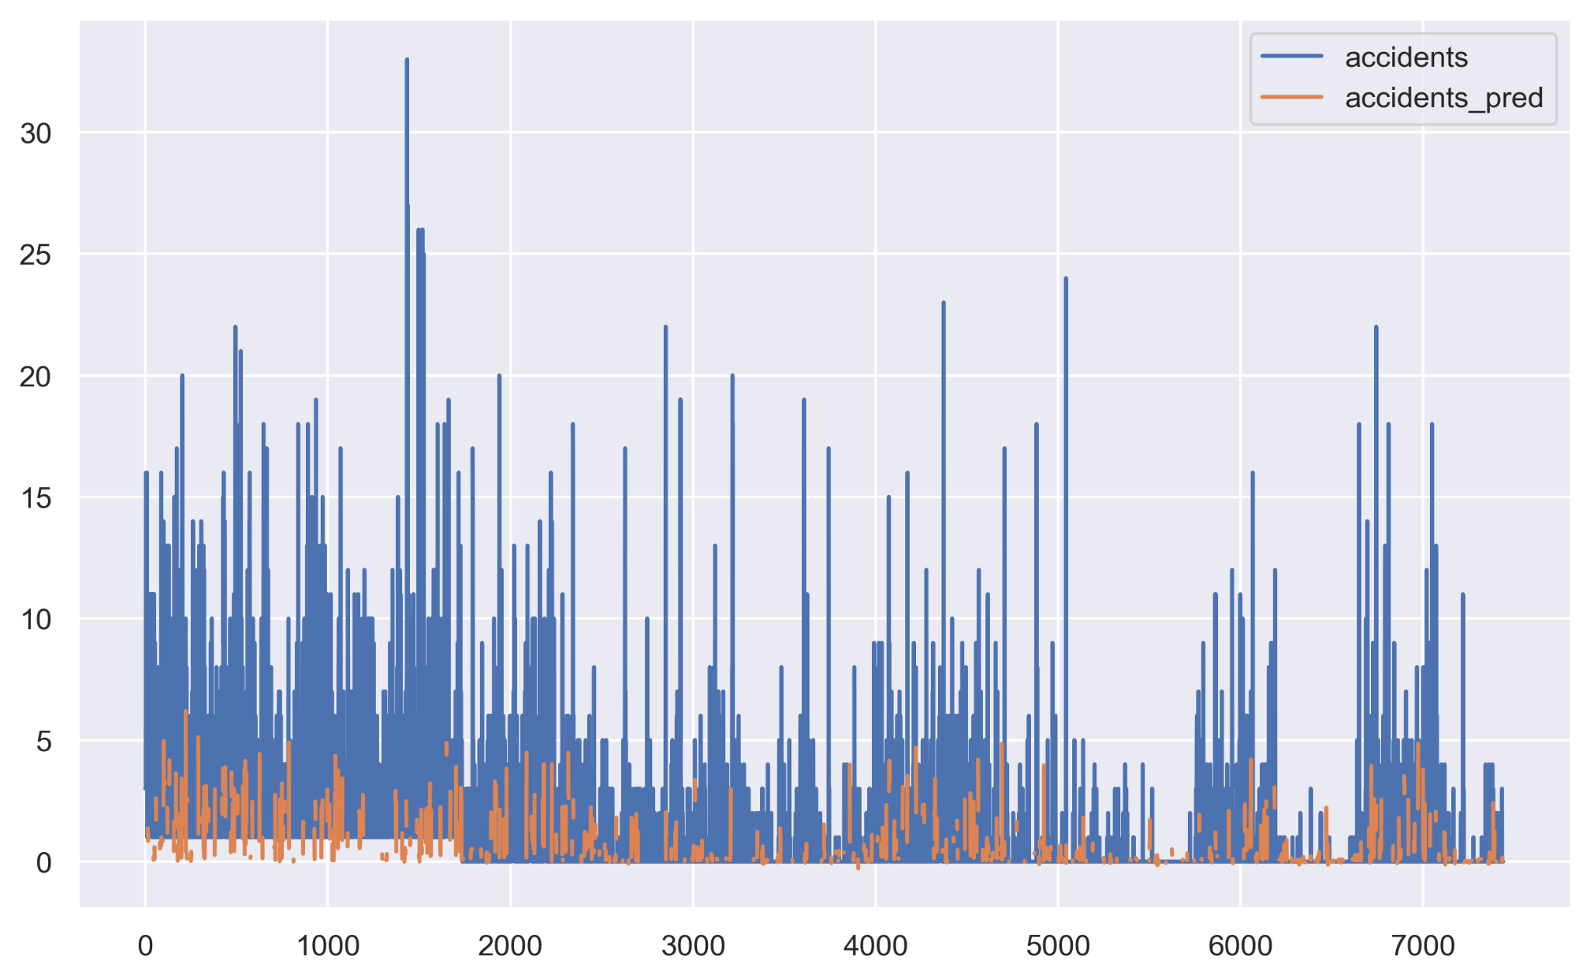
Normal_GSV—— Results
LGBM Model
Svm Model
Random Forest Model
R2: 0.21
MAE: 1.524
RMSE: 2.333
R2: 0.096
MAE: 1.282
RMSE: 2.495
R2: 0.26
MAE: 1.454
RMSE: 2.257
Decision Tree Model
Boosting Model
KNN Model
R2: -0.292
MAE: 1.668
RMSE: 2.982
R2: 0.181
MAE: 1.533
RMSE: 2.374
R2: 0.033
MAE: 1.45
RMSE: 2.581
Notes:
We employed the same approach for normal vehicles as well. When considering only GSV data, the Decision Tree Model, LightGBM Model, and Random Forest Model all exhibited relatively high R2 scores, though the Decision Tree Model displayed a negative correlation overall. At the same time, the MAE and RMSE values, in comparison to those for micro mobility, increased significantly, reaching 1.5 and 2.3, respectively.

Slide 20
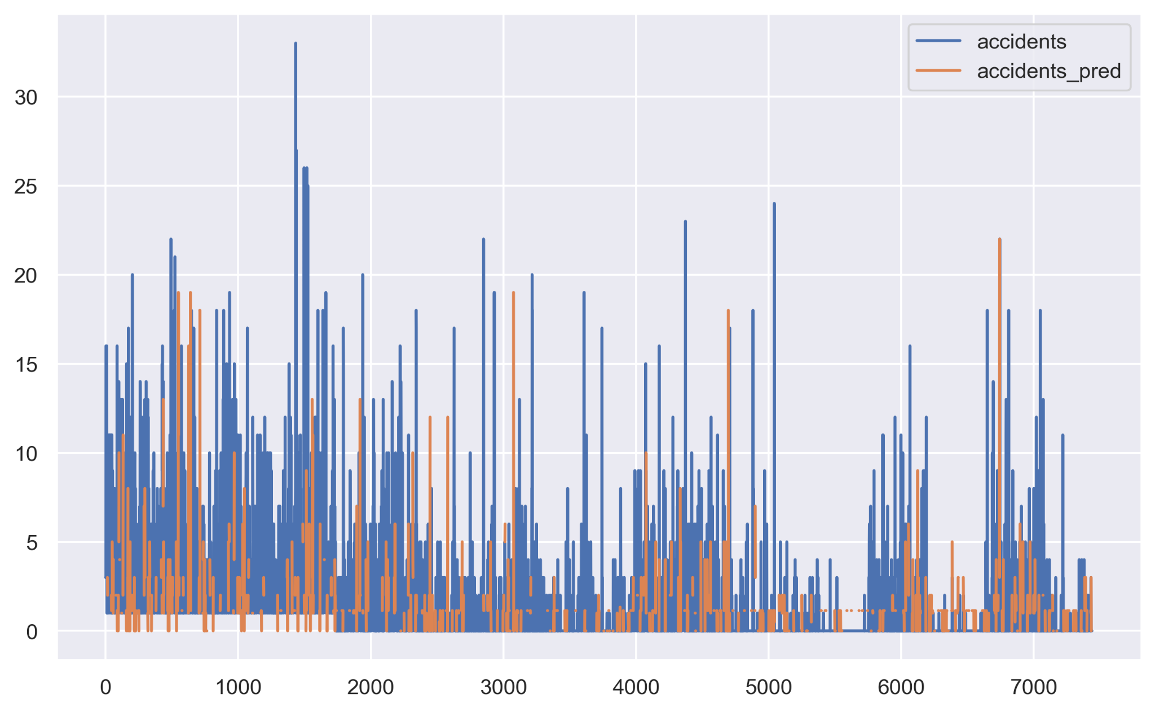
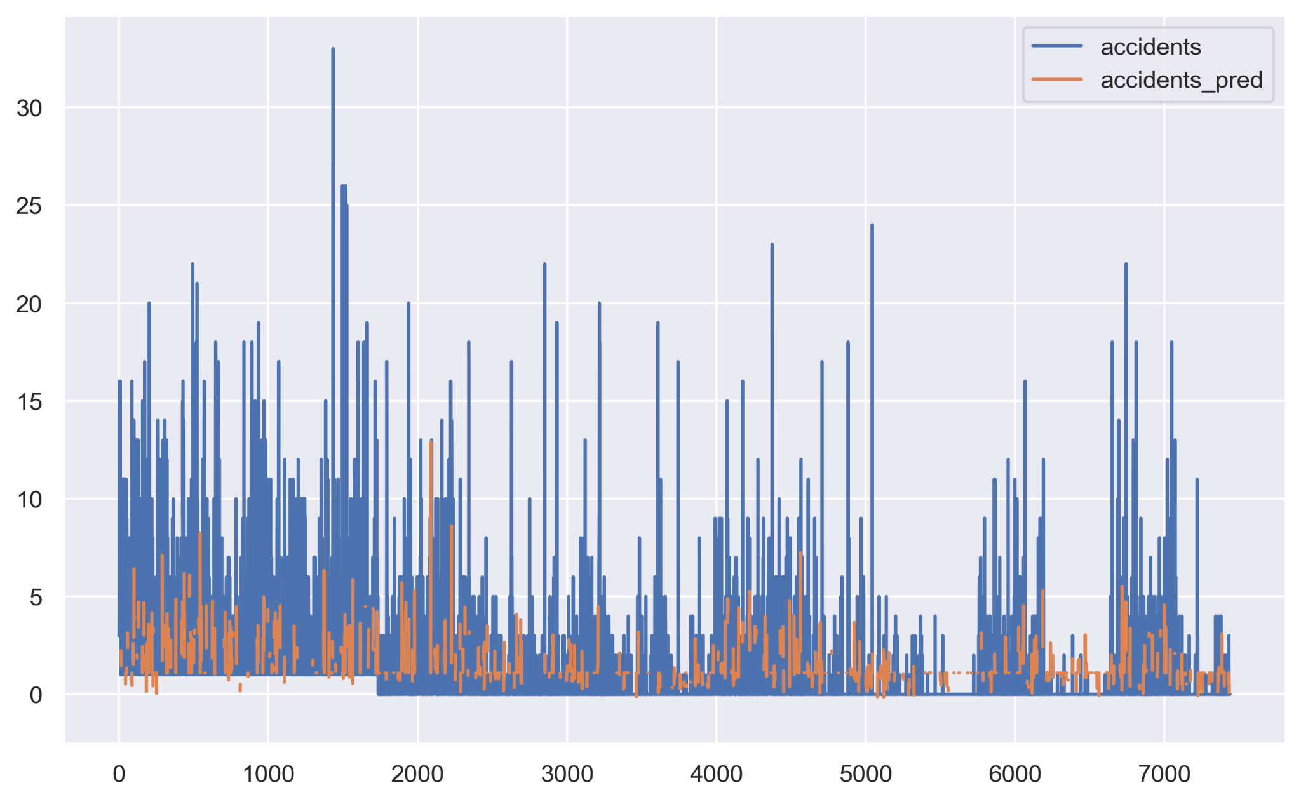
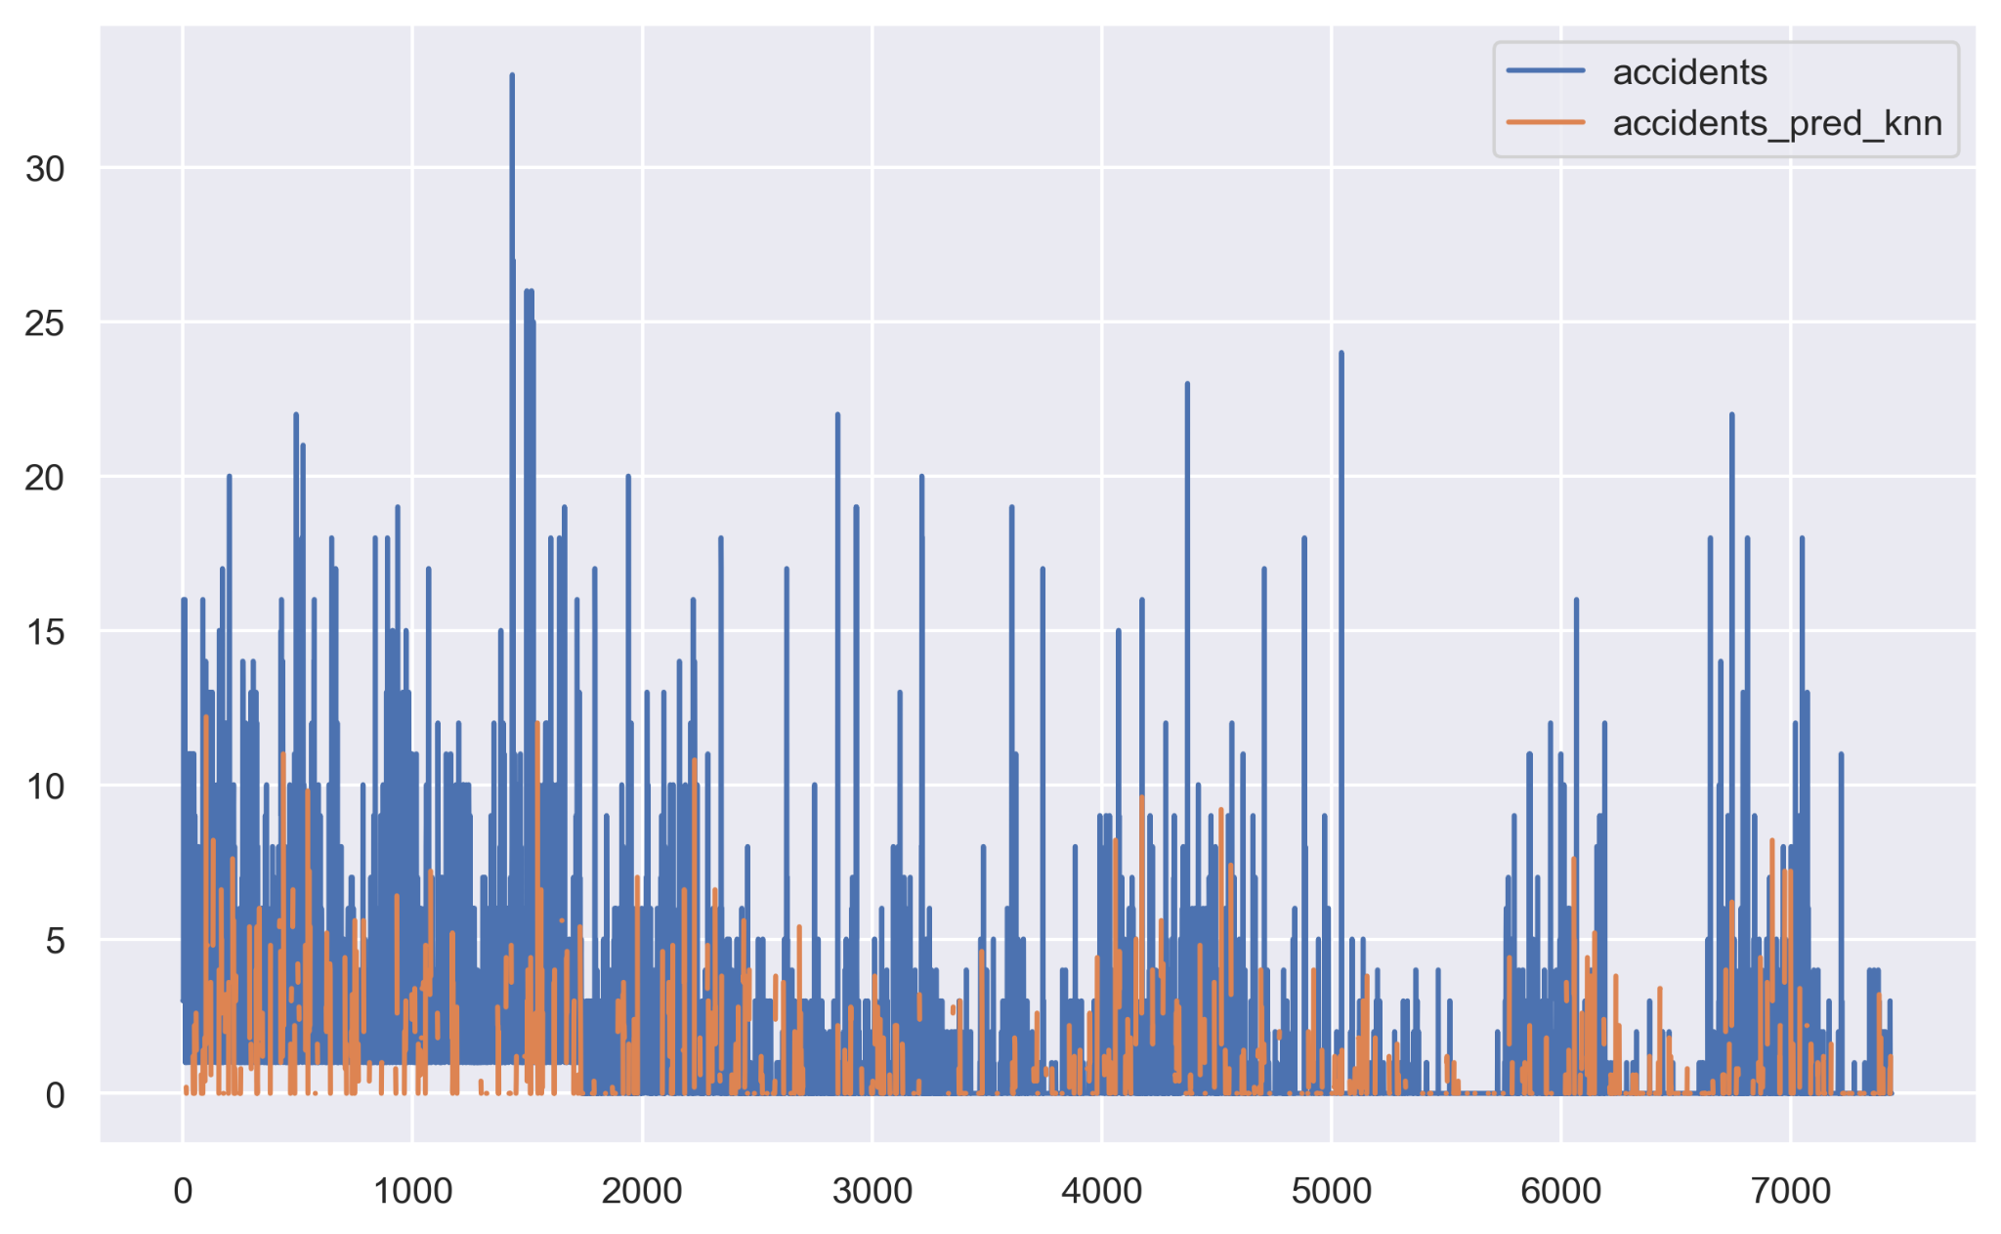
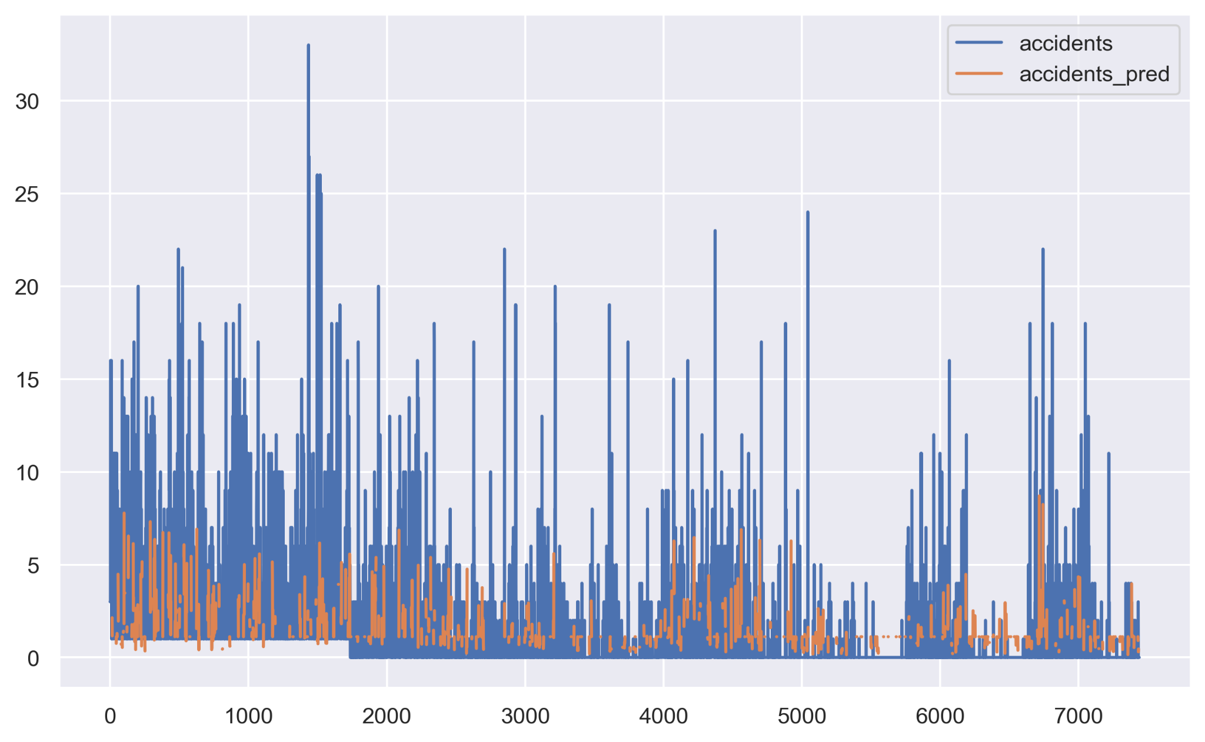
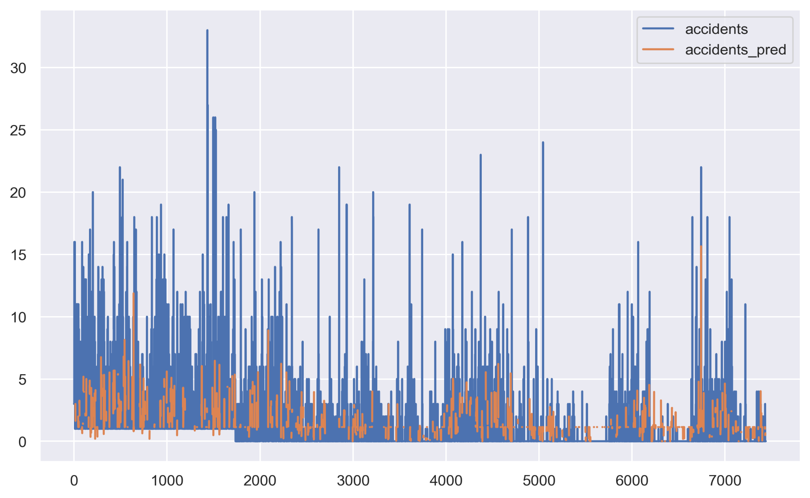
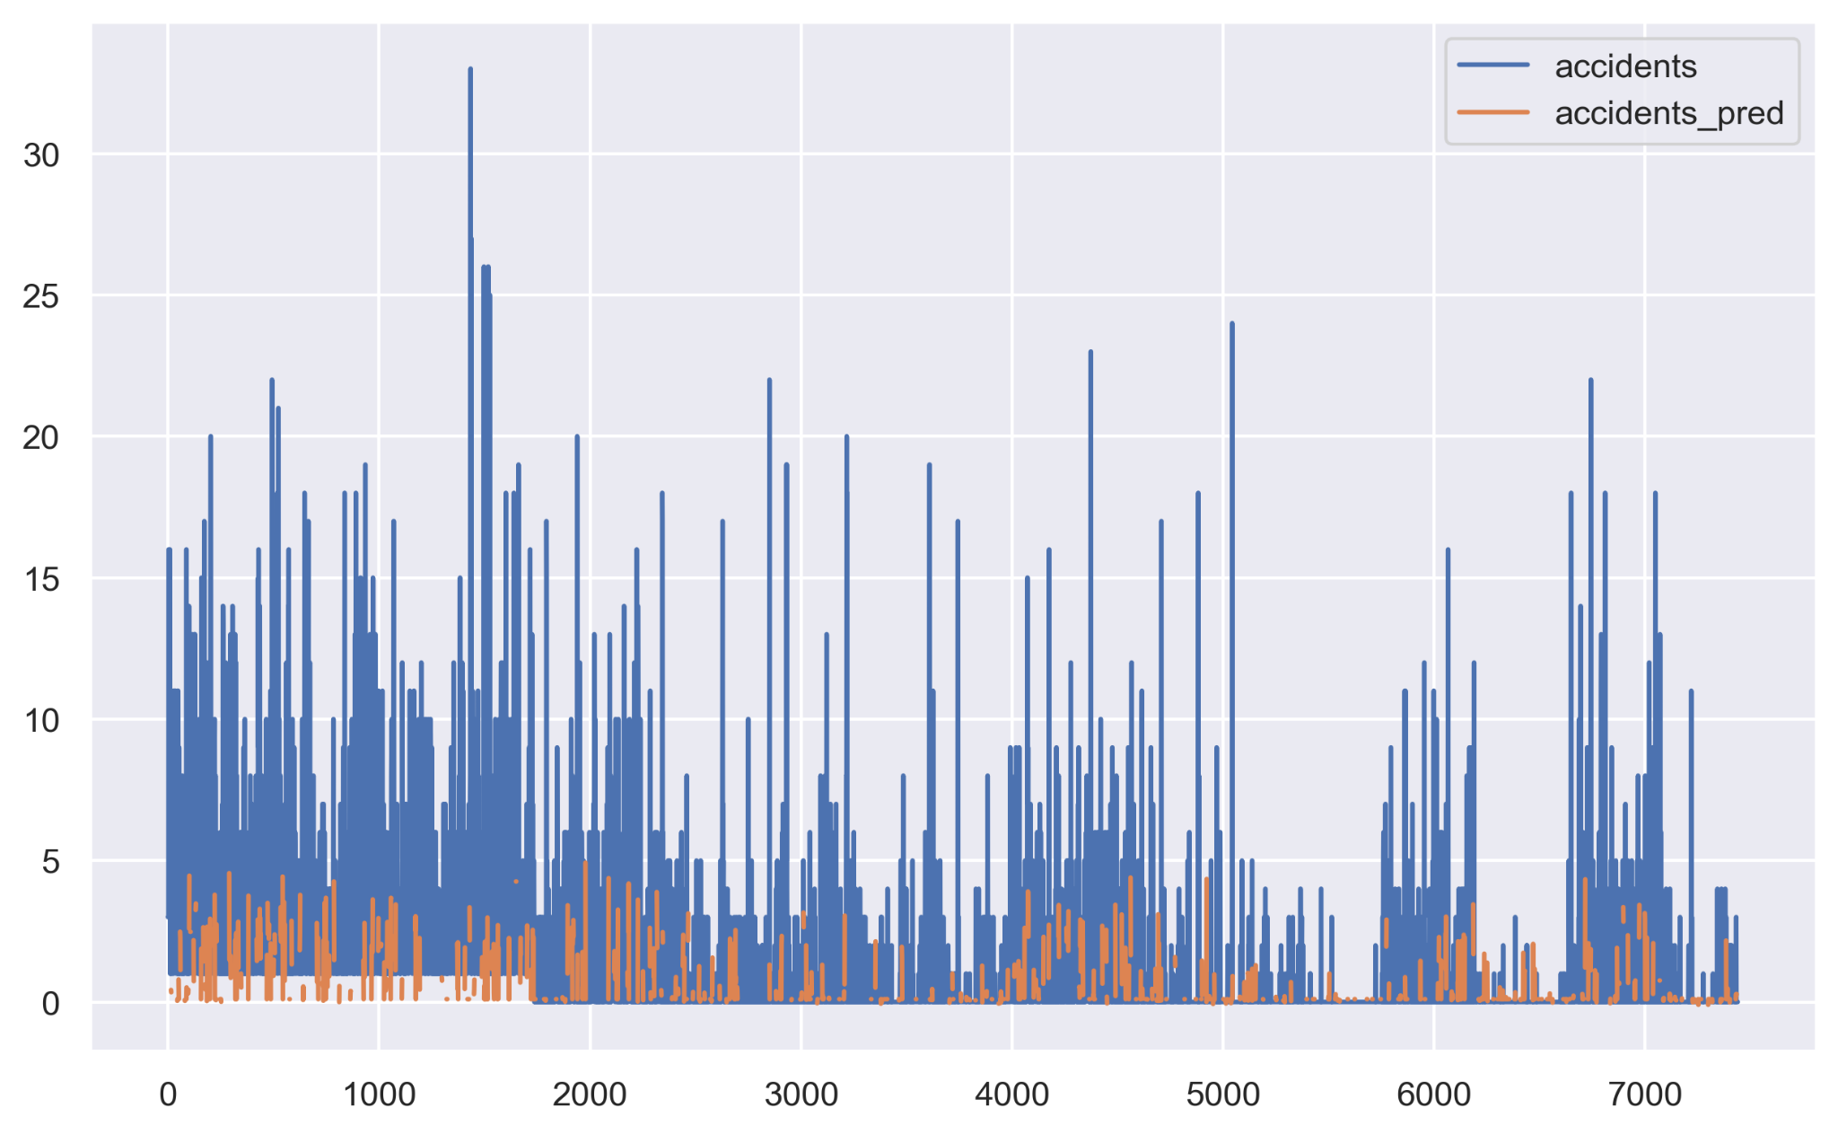
Normal_GSV+Land Cover—— Results
LGBM Model
Svm Model
Random Forest Model
R2: 0.377
MAE: 1.279
RMSE: 2.072
R2: 0.184
MAE: 1.207
RMSE: 2.37
R2: 0.39
MAE: 1.259
RMSE: 2.049
Decision Tree Model
Boosting Model
KNN Model
R2: -0.319
MAE: 1.588
RMSE: 3.013
R2: 0.361
MAE: 1.305
RMSE: 2.097
R2: 0.227
MAE: 1.4
RMSE: 2.307
Notes:
Upon incorporating Land Cover into our analysis, the overall performance of the models improved considerably. Among the six models, the Random Forest model demonstrated the best performance.

Slide 21
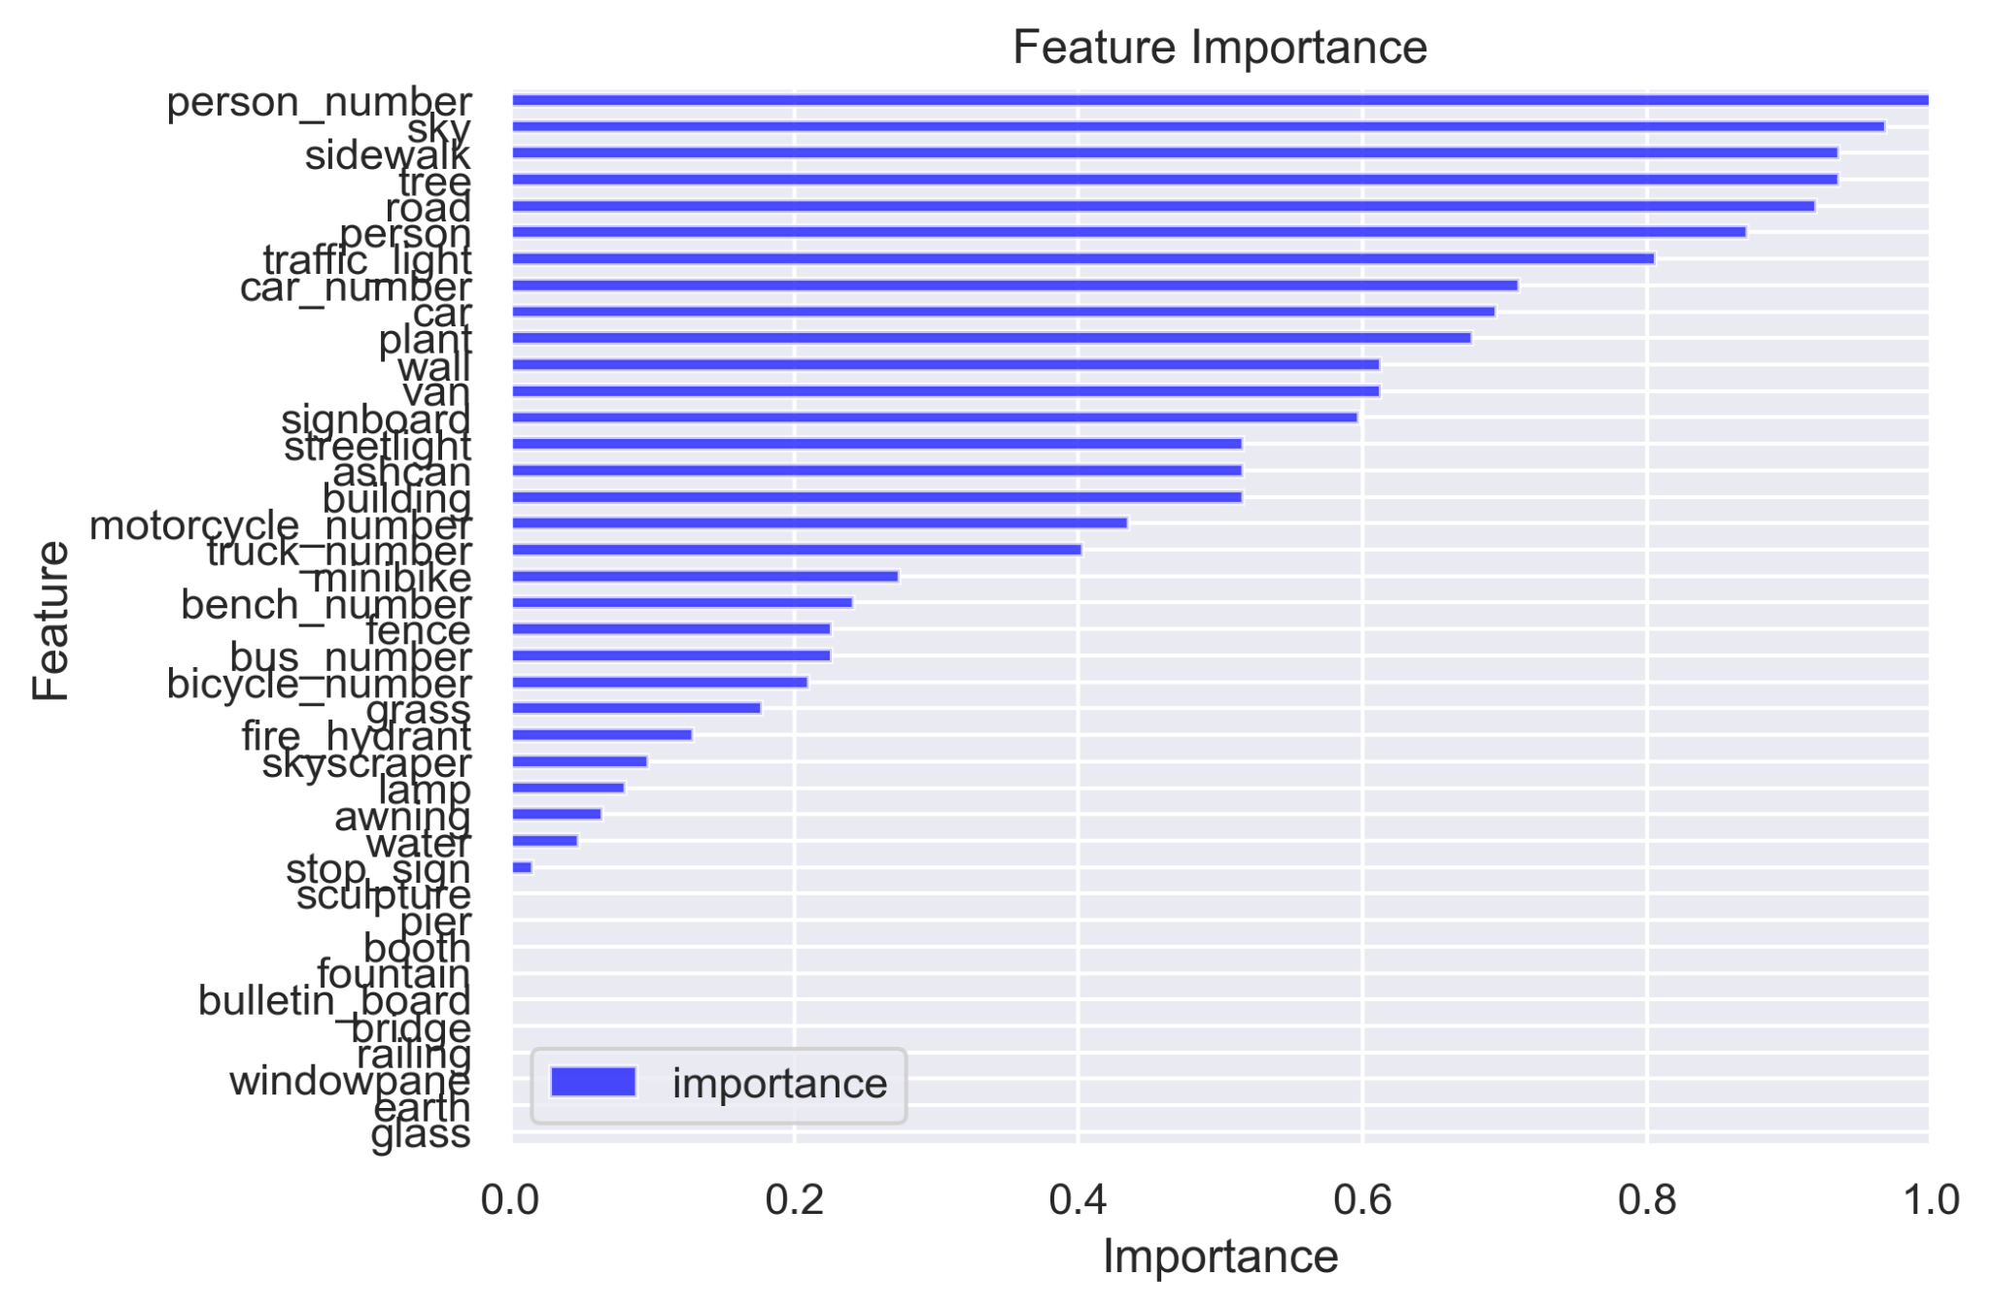
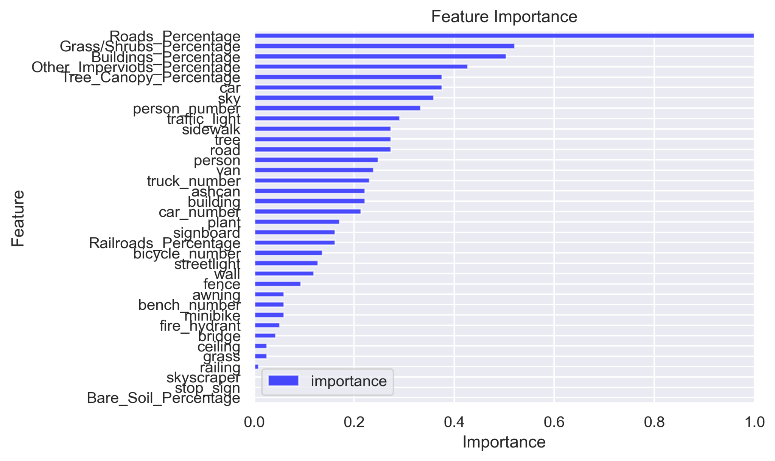
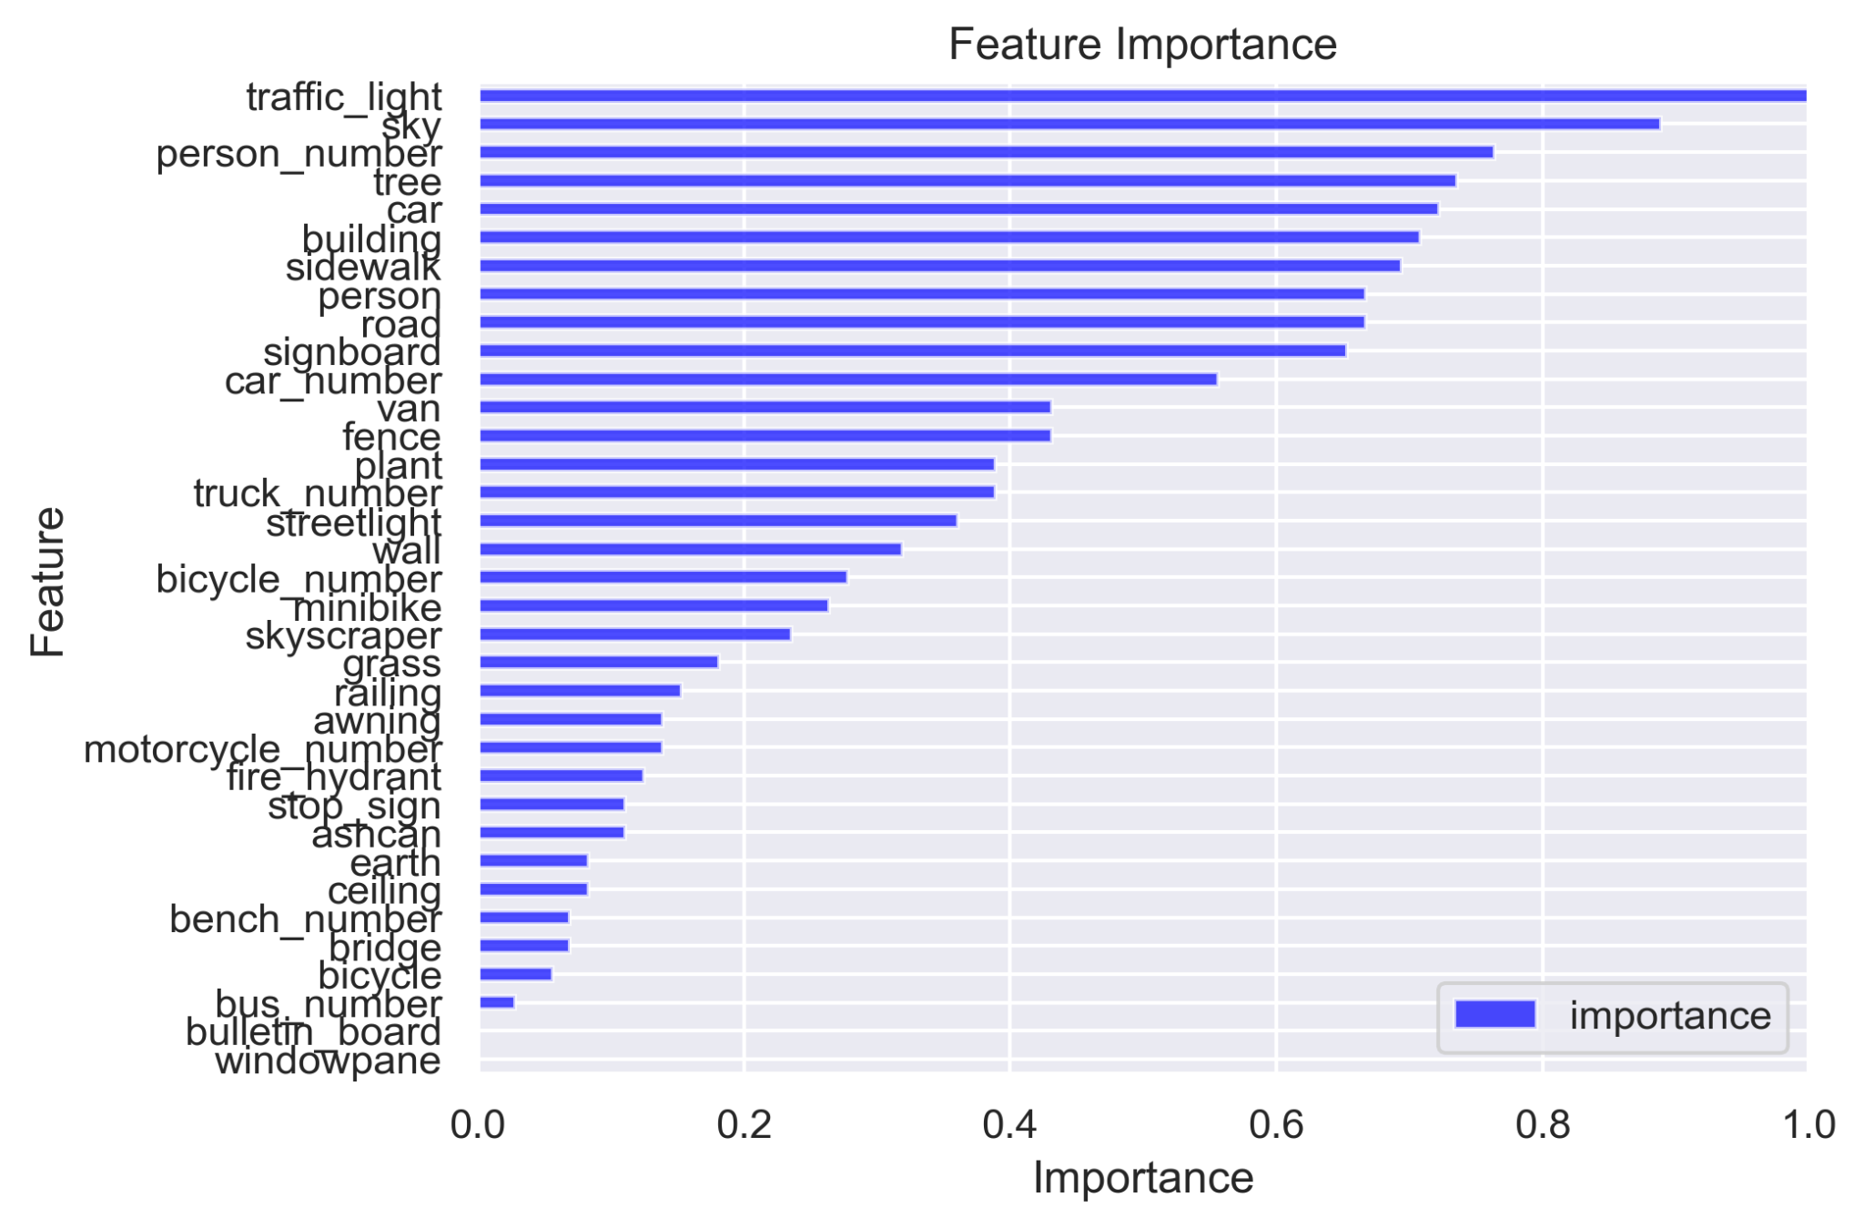
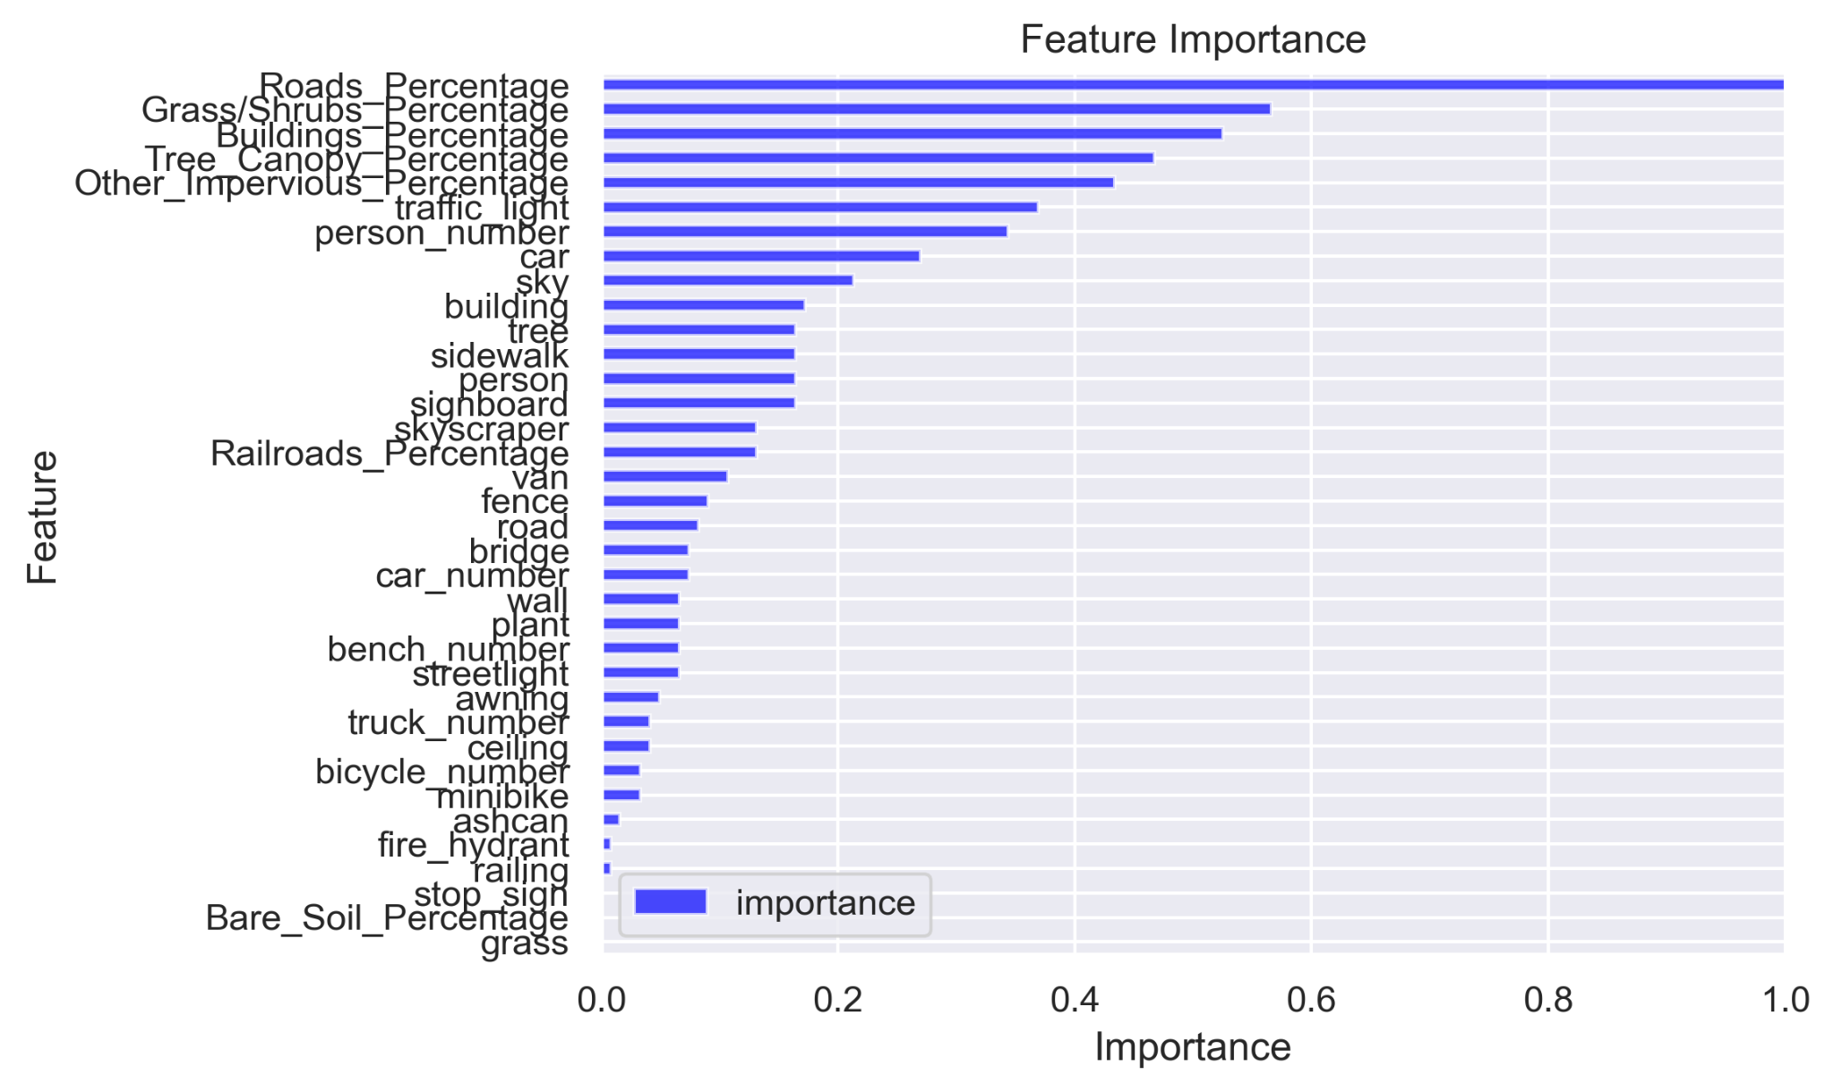
Micomobility_GSV—— Result
Micomobility_GSV +Land cover—— Result
Normal_GSV—— Result
Normal_GSV+Land cover—— Result
Notes:
We then ranked the features' importance during the regression of the Random Forest model using GINI importance. We found that, without considering Land Cover, parameters such as traffic light, tree, car, buildings, sky, and person had a relatively high impact. However, after including Land Cover, the road percentage became the most influential factor.

Slide 22
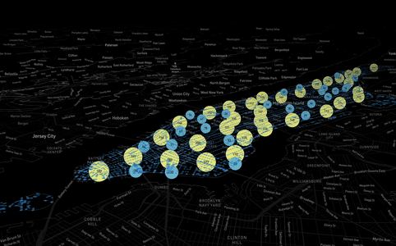
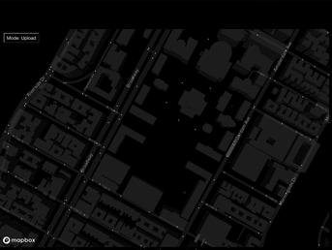
Future Development

Slide 23
Conclusions
Random forest takes the slowest time but has the highest R² and the best performance among all models.
The diameter size of the buffer zone can also be adjusted for comparative analysis.
After debugging the model with relatively optimal performance again, it is hoped that in the future, the risk of traffic collisions at road intersections in other low data areas can be predicted

